Slide 1
(v1.0 – November 2018)
Internal Only – DO NOT SHOW
Speaker:
Microsoft TSP/CSA, Partner
Audience:
TDM roles. This is a NON-NDA presentation; no NDA required unless forward-looking roadmap (slide 21) is disclosed.
Desired outcomes:
This presentation provides an overview of the Azure SQL Database service.
Objectives for this presentation are for the audience to gain an understanding of:
The importance of the cloud as part of a digital transformation.
The operational and financial benefits that are possible through Azure SQL Database.
The key scenarios and the Azure SQL Database features that enable them
The level of investment given to the Azure SQL Database roadmap, with estimated timing of upcoming releases. [NDA-only]
Length of presentation & How to Present:
6 hours including demos and labs
Talking points are available in the speaker notes section of each slide.
Deck Usage & Contact(s):
Owner: Colin Murphy
Messages and wording have been reviewed by stakeholders. Please be cautious and thoughtful in any changes you make to this approved messaging in your own content.
Send any suggested edits or comments to this file to the owner.
Translation of content is allowed.
Content in this file will be reviewed regularly for updates.
Do not remove disclaimers and citations from speaker notes.

Slide 2
Azure SQL Database Managed Instance Technical overview
Speaker
Date

Slide 3

Agenda
Intro to Azure SQL Database
Value prop, Platform benefits, TCO
Managed Instance overview
Managed Instance architecture, Features and management
Security & Networking
Security overview, Networking considerations, Hands-on-Lab
MI Features and capabilities
Key capabilities, limitations, backup & restore
Migration
Migration overview and options, Hands-on-Lab
MI & BI
Business Intelligence services + Managed Instance, Hands-on-Lab
Hyperscale
Hyperscale
Closing
Roadmap, technical resources, etc.,

Slide 4
Modernize in the Cloud with Azure SQL Database

Slide 5
Technology is shaping how businesses innovate and grow
Engage your customers
Transform your products
Digital transformation
Empower your employees
Optimize your operations
Notes:
Technology is omnipresent. It’s shaping how businesses plan for innovation and growth within their markets. The importance of digital transformation is urgent; Since 2000, 52% of Fortune 500 companies are gone due to digital disruption.
We see companies responding by creating digital strategies across four core areas: engaging their customers, empowering their employees, optimizing their operations, and transforming their products.

Slide 6
Getting ahead means getting to the cloud
Companies that embrace the cloud grow 19.6% faster
More than 80% of organizations now adopt cloud-first strategies
Notes:
Getting ahead means embracing digital transformation and getting to the cloud.
Studies show that companies that embrace the cloud grow 19.6% faster than those who do not.¹ More than 80% of organizations now adopt cloud-first strategies as part of an overall digital transformation.²
As a first step on that transformation, IT must optimize its operations to effectively manage growth in the cloud.
Sources:
1. IDC Digital Universe Executive Summary: https://www.emc.com/leadership/digital-universe/2014iview/executive-summary.htm
2. Building Trust in a Cloudy Sky
https://www.mcafee.com/us/resources/reports/rp-building-trust-cloudy-sky.pdf

Slide 7
IT optimization is key to digital transformation
SQL Server
Priorities
Eliminate time spent managing “long tail” of applications— lift and shift to managed cloud
Free up limited IT resources to drive transformation
Migrate business critical apps to cloud—extend and innovate
37% of all units run Microsoft, >50% of units run 2008/R2 or older ²
IDC Worldwide Database Server Forecast
¹ Pie Chart *IDC Worldwide DB Forecast Dec 2016
² Microsoft Internal Sources
Notes:
To stay competitive and get ahead in today’s marketplace, IT organizations are continuously looking at ways to optimize how they maintain and use the data that fuels their operations. Modernizing in the cloud as part of a digital transformation can deliver the right mix of operational efficiencies and business enablement to drive continued growth.
[click]
IT optimization is key to driving an organization’s digital transformation, and it introduces some new priorities for IT to consider:
Eliminate time spent managing “long tail” of applications—lift and shift to managed cloud
Free up limited IT resources to drive transformation
Migrate business critical apps to cloud—extend and innovate
The opportunity is significant. In a December 2016 study, IDC estimated that 37% of the global database installed base runs on Microsoft SQL Server, with over 50% running on 2008/R2 or older.

Slide 8
Azure SQL Database
The best and most economical cloud destination for your SQL server apps
Built-in intelligence
Breakthrough productivity and performance
Seamless and compatible
Competitive TCO
Realize up to a 212% ROI over on-premises and hosted solutions
Notes:
Azure SQL Database is a fully-managed relational database-as-a service that provides the best and most economical cloud destination for your customer’s SQL Server data. SQL Database uses the Microsoft SQL Server Engine, which means it’s high-performance, reliable, and secure. You can use it to build data-driven applications and websites in the programming language of your choice, without needing to manage infrastructure.
In addition to the benefits of a fully-managed service, SQL Database also provides key benefits in some specific areas:
It has built-in intelligence that helps you dramatically reduce the costs of running and managing databases and maximizes both the performance and security of your application.
SQL Database provides breakthrough productivity and performance to meet the demands of today’s apps. Each database is isolated from each other and portable, each with its own service tier with a guaranteed performance level. SQL Database provides different performance levels for different needs, and enables databases to be pooled to maximize the use of resources and save money. You can adjust performance with minimal downtime to your app. Dynamic scalability enables your database to transparently respond to rapidly changing resource requirements and enables you to only pay for the resources that you need when you need them. In-memory technologies provide real-time business insight with up to 30x improved throughput and latency and up to 100x faster queries and reports.
It provides the ability to seamlessly migrate SQL Server data to the cloud to a managed instance with a full SQL Server programming surface area that removes the need to re-architect the apps, saving you time and resources.
SQL Database combines the operational and financial benefits of a managed service with a financially-backed SLA and business continuity tools to protect the lifeblood of your business, your data. Microsoft offers economic incentives to maximize the return on investment of migrating SQL Server workloads to Azure and provide a competitive total cost of ownership for building new apps in the cloud.
¹The Total Economic Impact of Microsoft Azure SQL Database Managed Instance, Forrester Consulting, September 2018
]

Slide 9
Azure SQL Database resource types
SQL
Azure SQL Database
Single
Elastic Pool
Managed Instance
Database-scoped deployment option with predictable workload performance
Shared resource model optimized for greater efficiency of multi-tenant applications
Instance-scoped deployment option with high compatibility with SQL Server and full PaaS benefits
Best for apps that require resource guarantee at database level
Best for SaaS apps with multiple databases that can share resources at database level, achieving better cost efficiency
Best for modernization at scale with low friction and effort
Notes:
Introducing Azure SQL Database Managed Instance
SQL Database Managed Instance is an expansion of the existing SQL Database service designed to enable database migration to a fully-managed database service, without re-designing the application.
It’s important to note that Managed Instance isn’t a new service – it is a third resource type within Azure SQL Database, sitting alongside single databases and elastic pools. As part of Azure SQL Database, Microsoft’s fully managed cloud database service, it inherits all its built-in features.
A SQL Database Managed Instance offers a simplified instance-scoped programming model that is like an on-premises SQL Server instance. The databases in a SQL Database Managed Instance share the resources allocated to the Managed Instance, and the Managed Instance also represents the management grouping for these databases. The emphasis of this offering is on high compatibility with the programming model of an on-premises SQL Server and out-of-box support for a large majority of SQL Server features and accompanying tools/services.
Each standalone database is assigned a certain amount of resources via performance tiers: Basic, Standard, and Premium. The emphasis of this offering focuses on a simplified database-scoped programming model and applications with a predictable pattern and relatively stable workload.
An elastic database pool is a shared resource model that enables higher resource utilization efficiency, and all the databases within an elastic pool share predefined resources within the same pool. The emphasis of this offering is on a simplified database-scoped programming model for multi-tenant SaaS apps. The workload pattern is well-defined and is highly cost-effective in multi-tenant scenarios. For ISVs with SaaS apps, the savings can be significant, in the hundreds of thousands of dollars or more.

Slide 10
Built-in intelligence to protect and optimize
Intelligent Performance learns unique database patterns and automatically tunes for improved performance*
Intelligent Protection powers advanced data security features that monitor, detect, and alert on malicious activities and discover, track and remediate potential database vulnerabilities
Tuning algorithms
SQL
SQL Database
Database advisor
“My app gets auto-tuned”
“I can do more in less time”
Developer no admin skills
DBA of many databases
* Not available on MI
Notes:
The significant growth in data challenges IT organizations to strike a balance between the daily management and security of their data and the resources necessary to maintain it. IT organizations are faced with new demands on app performance, let alone remaining vigilant in the face of ongoing cybersecurity threats. Sometimes it can be a challenge to simply keep up with the limited resources on-hand.
With SQL Database, you get built-in Intelligent Performance that helps you dramatically reduce the costs of running and managing databases and maximizes both the performance and security of your application. Running millions of customer workloads around-the-clock, SQL Database collects and processes a massive amount of telemetry data, while also fully respecting customer privacy behind the scenes. Various algorithms are continuously evaluating the telemetry data so that the service can learn and adapt with your application. Based on this analysis, the service comes up with performance improving recommendations through Database Advisor, tailored to your specific workload.
Intelligent Protection powers advanced data security features like Threat Detection, which leverages SQL Database auditing to continuously monitor Azure SQL databases for potentially harmful attempts to access sensitive data. SQL Database Threat Detection provides a new layer of security, which enables customers to detect and respond to potential threats as they occur by providing security alerts on anomalous activities. Users receive alerts upon suspicious database activities, potential vulnerabilities, and SQL injection attacks, and anomalous database access patterns. SQL threat detection alerts provide details of suspicious activity and recommend action on how to investigate and mitigate the threat. Users can explore the suspicious events to determine if the event results from an attempt to access, breach, or exploit data in the database. Threat detection makes it simple to address potential threats to the database without the need to be a security expert or manage advanced security monitoring systems.
Vulnerability Assessment for Azure SQL Database provides you with a one-stop-shop to discover, track, and remediate potential database vulnerabilities. It gives visibility into your security state, and includes actionable steps to investigate, manage, and resolve security issues and enhance your database fortifications. The feature is now also part of a new security package for your Azure SQL Database, known as SQL Advanced Threat Protection, that provides a single go-to location for advanced SQL security capabilities, including Threat Detection, Vulnerability Assessment, and Information Protection (in preview).

Slide 11
Continuously optimized by the platform
Automatic tuning
One-click to enable
Prevent and mitigate issues
No app changes needed
Tuning actions
Create missing indexes
Drop unused/duplicate indexes
Force last good plan
Notes:
In addition to detecting issues on your databases, Azure SQL Database continuously looks for optimization opportunities for improving performance. The system tracks your usage patterns, distinguishes usual from adhoc workloads and finds the optimizations that can help the database’s usual workload. Imagine you have a lot of databases and some of these databases have the same workload, some different. Usage pattern of these databases depends on the end customer using the software. Now, fine tuning all of these databases takes a lot of time and it represents significant investment. Looking at another scenario, imagine you need to manage a suite of different applications. Let’s say you work in a big company with a lot of applications use internally for various purposes. Tuning all these different databases is even harder than tuning the DBs with similar workload. This is where automatic tuning fits right in You can enable automatic tuning through T-SQL or through Azure Portal.
Automatic tuning, continuously tunes your databases, by detecting the optimization opportunities. It’s one click to enable, it prevents and mitigates issues and requires no app changes. Specifically it can apply 3 tuning actions: create missing index, drop unused/duplicates, and force last good plan. It helps you improve performance, reduce resource usage, and total cost of ownership. Preventing and mitigating the issue reduces your DevOps time.

Slide 12
Put your database on auto-pilot and Focus on your business
Your work so far | How SQL Database helps
Hardware purchasing and management | Built-in scale on-demand
Protect data with backups (with health checks and retention) | Built-in point-in-time restore
High availability implementation | Built-in 99.99% SLA and auto-failover
Disaster recovery implementation | Built-in geo-redundancy and geo-replication
Ensure compliance with standards on your own | Built-in easy to use features
Secure your data from malicious users and mistakes | Built-in easy to use features
Roll out updates and upgrades | Built-in updates and upgrades
Monitor, troubleshoot, and manage at scale | Built-in easy to use features
Tune and maintain for predictable performance | Built-in easy to use features
We take care of your database chores
Notes:
In addition to the built-in intelligence, Azure SQL Database is a fully-managed service, which means Microsoft operates SQL Server for customers and ensures availability and performance. Features that come with SQL Database include, but are not limited to: provisioning and resizing (w/ Azure Portal experience), built-in auto HA (99.99%), automatic backup, point-in-time-restore (database-level), and active geo-replication. Because Microsoft assumes much of the daily maintenance, administration and infrastructure costs, your customer’s IT organization can quickly realize cost and operational benefits that they may not have otherwise experienced with their on-premises or hosted solution. In fact, Microsoft commissioned a study with Forrester Consulting that found that organizations who modernized their databases from SQL Server to SQL Database Managed Instance realized up to a 212% ROI over three years.¹
¹The Total Economic Impact of Microsoft Azure SQL Database Managed Instance, Forrester Consulting, September 2018

Slide 13
Breakthrough productivity and performance
30x faster transactions with in-memory OLTP
Realize the benefits of real-time operational analytics
Enable scale-up with near zero downtime through cloud-born innovation
100x performance gains with in-memory analytics
near 100%
uptime with dynamic scalability
Notes:
Experience up to 30x improved throughput and latency and up to 100x faster queries and reports with in-memory technologies.¹ In-memory OLTP can dramatically improve throughput and latency on transactional processing workloads and can provide significant performance improvements.
Dynamic scalability enables your database to transparently respond to rapidly changing resource requirements across all service tiers: Basic, Standard, Premium (Single databases and elastic pools); General Purpose and Business Critical (Managed Instance). Scale your app from a handful of databases to thousands and manage unpredictable demand patterns, within a budget and resources you control with elastic pools.
¹ “SQL Server In-Memory OLTP and Columnstore Feature Comparison” white paper, March 2016.

Slide 14
Save time with familiar SQL Server tools and resources
Full compatibility with SQL Server 2005+
Combine the best of SQL Server with the benefits of a fully-managed service
Use familiar SQL Server features in SQL Database Managed Instance
Native backup and restore
Cross-database queries and transactions
Broad security features including Transparent Data Encryption, SQL Audit, Always Encrypted and Dynamic Data Masking
SQL Agent, DBMail, and Alerts for workload orchestration improved awareness
Scenario enablers including Change Data Capture, Service Broker, Transactional Replication, and CLR
DMVs, XEvents, & Query Store for troubleshooting
Notes:
SQL Database Managed Instance combines the best of on-premises SQL Server with a fully managed database service, so that the migration becomes much easier.
SQL Database Managed Instance offers a simplified instance-scoped programming model that is like an on-premises SQL Server instance. The databases in Managed Instance share the resources allocated to the Managed Instance, and the Managed Instance also represents the management grouping for these databases. The emphasis of this offering is on high compatibility with the programming model of on-premises SQL Server and out-of-box support for the large majority of SQL Server features and accompanying tools/services.

Slide 15
Dedicated resources through customer isolation
VNET support in SQL Database Managed Instance
Enable full isolation from other tenants without resource sharing
Promote secure communication over private IP addresses with native VNET integration
Enable your on-premise identities on cloud instances, through integration with Azure Active Directory and AD Connect
VNet-to-VNet
Web app (public IP)
VNet2
SQL instance #1
SQL instance #2
Network isolation (customer VNET)
Tenant isolation (compute, storage)
SQL instance #3
VNet1
“Virtual data cluster” dedicated to customer (virtual private cluster, VNET, private IPs)
VPN/Express route gateway
On-premises
Notes:
SQL Database Managed Instance provides complete workload isolation of your workloads through native VNET support.
We use virtual data clusters to describe the degree of isolation that customer workloads will experience with SQL Database Managed Instance. During service provisioning (on Azure Portal or through REST API), you can choose the virtual network (VNET) and the subnet to achieve full networking isolation for your Managed Instances. Once created, instances in the VNET can be reached using Azure networking mechanisms (VPN and Express Route gateways).
To two levels of isolation are provided:
Cluster (tenant ring) level: Managed Instances for a tenant are fully isolated from other tenants. No connectivity or resource sharing is possible between different tenants.
Networking level: joining instances to a subnet in a VNET and restricting access to private IP addresses only provides full isolation from public Internet.

Slide 16
Competitive total cost of ownership
Up to 212% ROI with Azure SQL Database
Reduce capital and operational costs with a fully-managed service and achieve up to 406% ROI ¹
Financially-backed 99.99% availability SLA2
Promote business continuity with built-in capabilities
Maximize your on-premises investments with Azure Hybrid Benefit for SQL Server and reserved capacity pricing
Right-size on-premises workload requirements for the cloud with independent control of storage and compute
Source: The Total Economic ImpactTM of Microsoft Azure SQL Database Managed Instance, Forrester Consulting, September 2018
Notes:
You can achieve up to 212% ROI or more versus on-premises and hosted alternatives with SQL Database Managed Instance. Lower operational costs and redirect resources to more value-add projects using a fully-managed solution that requires near-zero administration for patching or upgrading. Microsoft commissioned a Total Economic ImpactTM study with Forrester Consulting which found that organizations can achieve up to 212% ROI on Azure SQL Database Managed Instance by minimizing IT administrative costs, reducing capital and operational costs associated with maintaining on-premises or hosted databases and minimizing the costs associated with rearchitecting apps for the cloud, among others, resulting in a cumulative net benefit of nearly $2.2M over a 3-year period.
Protects your data and maintains business continuity with built-in high availability and business continuity tools. Azure's financially-backed 99.99% availability SLA², powered by a global network of Microsoft-managed datacenters over 38 regions, helps keep their apps running 24/7. In addition, SQL Database provides built-in business continuity and global scalability features such as automatic backups, point in time restores and active geo-replication to minimize data loss and achieve fast recovery after disruptive events.
Minimize data loss from disruptive events achieve recovery with recovery point objective (RPO) of less than 5 seconds. (AWS provides an RPO commitment of 5 minutes)
Protect against data center outages with up to four readable secondary databases enabled through active geo-replication.
Automatically create full, differential, and transaction log backups every 5 - 10 minutes.
Restore an existing database to an earlier point in time up to 35 days on the same logical server.
Maximize the value from current on-premises licensing investments and accelerate their modernization to the cloud with Azure Hybrid Benefit for SQL Server. Azure Hybrid Benefit for SQL Server helps you get more value from their SQL Server licenses with Software Assurance by providing discounted rates on vCore-based SQL Database resource types.
Significantly reduce costs—up to 33 percent compared to license-included prices—with one-year or three-year terms on vCore-based SQL Database options. You can lower your total cost of ownership by combining reserved capacity with license-included prices to manage costs across predictable and variable workloads. You can improve budgeting and forecasting with a single upfront payment, making it easy to calculate your investments.
¹ The Total Economic ImpactTM of Microsoft Azure SQL Database Managed Instance, Forrester Consulting, September 2018
² We guarantee at least 99.99% of the time customers will have connectivity between their single or elastic Basic, Standard, or Premium Microsoft Azure SQL Database and our Internet gateway. See “SLA for SQL Database” for more information (https://azure.microsoft.com/en-us/support/legal/sla/sql-database/v1_1/)

Slide 17


DTUs simplify certain elements for customers but can make on-premises transitions difficult
Challenges with translating on-premises workload requirements to the cloud when migrating
More flexibility desired to optimize resources for SQL Database workloads
Notes:
The Database Transaction Unit (DTU) is the unit of measure in SQL Database that represents the relative power of databases based in a real-world measure: the database transaction. Microsoft took a set of operations that are typical for an online transaction processing (OLTP) request, and then measured how many transactions could be completed per second under fully loaded conditions.
While DTUs simplify many elements for customers looking for an off-the-shelf, preconfigured solution, customers transitioning to the cloud need more flexibility and choice – more options.
When migrating to the cloud, you must inventory your on-premises workloads to determine the right amount of resources to purchase in the cloud based upon on-premises needs. You need a straightforward way to map compute, storage and the like to SQL Database resources.
Once in the cloud, you’ll want the flexibility to optimize performance for a particular workload, which requires independent control of compute and storage resources to meet your needs.

Slide 18
Right-size your workloads for the cloud
Introducing vCores
Easier to right-size the destination environment by removing the guesswork of DTUs
You pay only for what you use
1 on-premises core = 1 vCore on Gen4 hardware
Notes:
We’d like to introduce the vCore, the basis of the new purchasing model.
A virtual core (vCore) is a representation of compute power in the cloud. A virtual core represents the logical CPU available for your server offered with an option to choose between generations of hardware.
Managed Instance, for example, is tailored for on-premises workloads that are looking to move to the cloud. Customers with these workloads are accustomed to sizing these using physical cores on-premises. Thus, a vCore is a simpler way to understand compute requirements in the cloud vs. what is in use on-premises today, allowing you to right-size your destination environment in the cloud and pay only for what you use.
NOTE: For servers created using Gen4 vCores, they are based on Intel E5-2673 v3 (Haswell) 2.4 GHz processors. For servers created using Gen5 vCores, they are based on Intel E5-2673 v3 (Haswell) 2.4 GHz processors.

Slide 19
Selecting the right purchasing option
Flexibility
Simplicity
vCore-based
Independently configure compute, storage, IO
Most economical with Azure Hybrid Benefit for SQL Server
DTU-based
Blended measure of compute, storage, IO
May be more economical for < 3 cores
Compare vCore-based and DTU-based options using this rule of thumb: 100DTU ~ 1 vCore
Convert from DTU to vCore using the API or portal with no downtime and same SLO update as today
Notes:
So, how do you select the right option for your workload? To start, both models provide the benefits of a fully-managed service such as automated backups, software updates and patches. After that, it comes down to your preference and their workload requirements.
For customers who need more insight into the underlying resources or need to scale them independently to optimize performance, the vCore-based model will be the best choice. Additionally, if you have an active Software Assurance (SA) for SQL Server, you can use your existing investment and save up to 55% with Azure Hybrid Benefit for SQL Server.
However, if you do not want to worry about the underlying resources and prefer the simplicity of a preconfigured bundle and pay a fixed amount each month, the DTU-based model may be more suitable for your needs.
[The Database Throughput Unit (DTU) is based on a blended measure of CPU, memory, reads, and writes. The DTU-based performance levels represent preconfigured bundles of resources to drive different levels of application performance.]
You may be interested in moving your DTU-based workloads to vCore-based and may have questions about how to compare them, “apples to apples.”
The new vCore-based service tiers offer comparable performance choices for all elastic pools and databases using 100 DTUs or more.
For existing SQL Database applications using the DTU-based model, the General Purpose service tier is comparable to the Standard tier. The Business Critical service tier is comparable to the Premium tier. In both cases, customers should allocate at least 1 vCore for each 100 DTU that their application uses in the DTU-based model. We will continue to add more SLOs over time to accommodate for sub-100 DTU workloads.
The new vCore-based service tiers offer a simple online conversion method that is similar to the existing process of upgrading databases from Standard to Premium service tier and vice versa. This conversion can be initiated using Portal, ARM, PowerShell, Azure CLI or T-SQL.

Slide 20
Committed to customer choice
Choose from three tiers in the vCore-based model
 | GENERAL PURPOSE |  | HYPERSCALE | BUSINESS CRITICAL
Best for | Most business workloads. Offers budget oriented balanced compute and storage options |  | Data applications with large data capacity requirements and the ability to auto-scale storage and scale compute fluidly | OLTP applications with high transaction rate and low latency IO. Offers highest resilience to failures using several isolated AlwaysON replicas
Compute tiers | Two hardware generations to choose from
 | Single/Elastic Pools | Managed Instance | Single database | Single/Elastic Pools | Managed Instance
 | 1 to 80 vCores | 8, 16, 24, 32, 40, 64, 80 vCores | 1 to 80 vCores | 1 to 80 vCores | 8, 16, 24, 32, 40, 64, 80 vCores
Storage | Premium remote storage (per instance) |  | De-coupled storage with local SSD cache (per instance) | Super-fast local SSD storage (per instance)
 | Single/Elastic Pools | Managed Instance | Single database | Single/Elastic Pools | Managed Instance
 | 5GB – 4TB | 32GB – 8TB | Up to 100TB | 5GB – 4TB | 32GB – 4TB**
Availability | 1 replica, no read-scale |  | Configurable replicas, up to 15 read-scale | 3 replicas, 1 read-scale, zone-redundant HA***
Backups | RA-GRS, 7-35 days (7 days by default) |  | RA-GRS, 7-35 days (7 days by default), constant time PITR | RA-GRS, 7-35 days (7 days by default)
Choice drives our approach to resource management and pricing
Simplicity: We remain committed to the DTU-based model and the simplicity it offers customers who want a pre-configured solution
Flexibility: The vCore-based model reflects our commitment to customer choice and to simplify the hybrid benefit for customers migrating from on-premises
Customers pay for
Service tier + number of vCores
Type and amount of data storage
Number of IO*
Backup storage (RA-GRS)*
The vCore-based model will exist alongside the DTU-based model
Learn more
*Free during preview
**4TB available on Gen 5 only
***Coming soon
Notes:
We’re committed to customer choice and as such, the DTU-based model and vCore-based models will both be available to SQL databases and elastic pools, offering simplicity and flexibility when it comes to resource management and pricing. The DTU-based model will not be available in the Managed Instance option.
The vCore-based model includes three options, differentiated by the level of HA and storage performance required by the customer’s workload. These three options are General Purpose, Hyperscale and Business Critical.
General Purpose is great for most business workloads. It offers budget-oriented, balanced and scalable compute and storage options.
Hyperscale is best for data applications with large data capacity requirements and the ability to auto-scale storage and scale compute fluidly. Hyperscale is currently in preview and available for single databases only at this time.
Business Critical is great for business applications that have high IO requirements. It offers the highest resilience to failures using 3 isolated AlwaysON replicas with one read-scale.
Within these options, pricing will be based upon the number of vCores and storage and whether the license is included or if the customer is using the Azure Hybrid Benefit for SQL Server to maximize their on-premises license investment.

Slide 21
Azure is the most economical destination for SQL Workloads*
Save up to 80% with Azure Hybrid Benefit for SQL Server and SQL Database reserved capacity
Use your on-premises SQL Server licenses with active Software Assurance to save up to 55% on vCore-based SQL Database deployment options with Azure Hybrid Benefit for SQL Server
Pre-pay your SQL Database compute capacity on a one or three-year term and save up to 33% with SQL Database reserved capacity
Combine the Azure Hybrid Benefit for SQL Server and SQL Database reserved capacity for even more savings, up to 80%
Learn more
Azure Hybrid Benefit
Azure SQL Database reserved capacity
Total monthly cost of 8 vCore Managed Instance Business Critical option
Up to 55% savings¹
Up to 80% savings²
Customer total cost
License included
With Azure Hybrid Benefit
Reserved capacity with Azure Hybrid Benefit
*Based upon comparison of on-demand pricing on Azure for Managed Instance versus running SQL on AWS RDS.
¹ Savings based on eight vCore Managed Instance Business Critical in East US Region, running 730 hours per month. Savings are calculated from full price (license included) against base rate (applying Azure Hybrid Benefit for SQL Server), which excludes Software Assurance cost for SQL Server Enterprise edition, which may vary based on EA agreement. Actual savings may vary based on region, instance size and performance tier. Prices as of May 2018, subject to change.
² Savings based on eight vCore SQL Database Managed Instance Business Critical in West 2 US Region, running 730 hours per month. Savings are calculated from on demand full price (license included) against base rate with Azure Hybrid Benefit plus 3-year reserved capacity commitment. Savings excludes Software Assurance cost for SQL Server Enterprise edition, which may vary based on EA agreement. Actual savings may vary based on region, instance size and performance tier. Prices as of May 2018, subject to change.
Notes:
Today, your SQL Server licenses and active Software Assurance can save you up to 55% when you use Azure Hybrid Benefit for SQL Server when migrating to the new vCore-based deployment options in SQL Database. Now, with support for reserved capacity on single databases, elastic pools and managed instance, you can unlock even more savings when you combine your Azure Hybrid Benefit with reserved vCore pricing to achieve savings of up to 80%. You can achieve the lowest cost of ownership by combining reservation pricing with the Azure Hybrid Benefit. You also have the option to combine reservation pricing with license-included prices. Reservations help you manage costs across predictable and variable workloads and improve budgeting and forecasting with a single upfront payment, making it easy to calculate investments.

Slide 22
Exclusive to Azure: Get more for your virtualized workloads
SQL Server license trade-in values
SQL Database Managed Instance
Take an inventory of on-premises licenses to determine potential for conversion
Convert on-premises cores to vCores to maximize value of investments
1 Standard license core = 1 General Purpose core
1 Enterprise license core = 1 Business Critical core
1 Enterprise license core = 4 General Purpose cores (virtualization benefit)
General Purpose
Business Critical
General Purpose
OR
Highly virtualized, Enterprise Edition
Enterprise Edition
Standard Edition
SQL Server with Software Assurance
Notes:
There is an additional benefit in the Azure Hybrid Benefit for SQL Server that is exclusive to Azure and a unique benefit over license mobility. SQL Server Enterprise Edition customers can use an unlimited virtualization benefit for their on-premises workloads. However, moving to the cloud to take advantage of its management, flexibility and cost benefits can be cost prohibitive for some heavily virtualized customers. The hybrid benefit provides SQL Server Enterprise Edition customers with Software Assurance the ability to get 4 cores in the cloud for every 1 core they own on-premises for workloads moving to the General Purpose SKU. This makes moving virtualized applications to SQL Database highly cost effective as customers will not have to purchase incremental vCores to move their virtualized application to the cloud.
---------------------------
Virtualization creates a simulated, or virtual, computing environment as opposed to a physical environment. Virtualization often includes computer-generated versions of hardware, operating systems, storage devices, and more. This allows organizations to partition a single physical computer or server into several virtual machines. Each virtual machine can then interact independently and run different operating systems or applications while sharing the resources of a single host machine.

Slide 23
Agenda
Intro to Azure SQL Database
Value prop, Platform benefits, TCO
Managed Instance overview
Managed Instance architecture, Features and management
Security & Networking
Security overview, Networking considerations, Hands-on-Lab
MI Features and capabilities
Key capabilities, limitations, backup & restore
Migration
Migration overview and options, Hands-on-Lab
MI & BI
Business Intelligence services + Managed Instance, Hands-on-Lab
Hyperscale
Hyperscale
Closing
Roadmap, technical resources, etc.,

Slide 24
Azure SQL Database deployment types
SQL
Azure SQL Database
Single
Elastic Pool
Managed Instance
Database-scoped deployment option with predictable workload performance
Shared resource model optimized for greater efficiency of multi-tenant applications
Instance-scoped deployment option with high compatibility with SQL Server and full PaaS benefits
Best for apps that require resource guarantee at database level
Best for SaaS apps with multiple databases that can share resources at database level, achieving better cost efficiency
Best for modernization at scale with low friction and effort
Notes:
Introducing Azure SQL Database Managed Instance
SQL Database Managed Instance is an expansion of the existing SQL Database service designed to enable database migration to a fully-managed database service, without re-designing the application.
It’s important to note that Managed Instance isn’t a new service – it is a third resource type within Azure SQL Database, sitting alongside single databases and elastic pools. As part of Azure SQL Database, Microsoft’s fully managed cloud database service, it inherits all its built-in features.
A SQL Database Managed Instance offers a simplified instance-scoped programming model that is like an on-premises SQL Server instance. The databases in a SQL Database Managed Instance share the resources allocated to the Managed Instance, and the Managed Instance also represents the management grouping for these databases. The emphasis of this offering is on high compatibility with the programming model of an on-premises SQL Server and out-of-box support for a large majority of SQL Server features and accompanying tools/services.
Each standalone database is assigned a certain amount of resources via performance tiers: Basic, Standard, and Premium. The emphasis of this offering focuses on a simplified database-scoped programming model and applications with a predictable pattern and relatively stable workload.
An elastic database pool is a shared resource model that enables higher resource utilization efficiency, and all the databases within an elastic pool share predefined resources within the same pool. The emphasis of this offering is on a simplified database-scoped programming model for multi-tenant SaaS apps. The workload pattern is well-defined and is highly cost-effective in multi-tenant scenarios. For ISVs with SaaS apps, the savings can be significant, in the hundreds of thousands of dollars or more.

Slide 25
Azure relational database platform
Power BI
Azure App Services
Azure Data Factory
Azure Analysis Services
Azure Machine Learning
Azure Cognitive Services
Azure Bot Service
Azure SQL Database
SQL Data Warehouse
PostgreSQL
MySQL
MariaDB
Database Services Platform
Intelligent Advisors, tuning, monitoring
Flexible On-demand scaling, resource governance
Trusted HA/DR, backup/restore, security, audit, isolation
Azure compute
Azure storage
Global Azure in 43 regions

Slide 26
Azure relational database platform
Power BI
Azure App Services
Azure Data Factory
Azure Analysis Services
Azure Machine Learning
Azure Cognitive Services
Azure Bot Service
Single
Elastic Pool
Managed Instance
Standard
Business Critical
SQL Data Warehouse
PostgreSQL
MySQL
MariaDB
Azure SQL Database
Database Services Platform
Azure compute
Azure storage
Global Azure in 43 regions
Notes:
Managed Instance - New deployment option enabling friction-free migration of SQL Server workloads to a fully-managed service

Slide 27

Who is Managed Instance for?
SQL
Customers looking to migrate a large number of apps from on-premise or IaaS, self-built or ISV provided, with as low migration effort as possible & cost being a crucial factor

Slide 28
Azure Database migration journey
SQL
Managed Instance
*
Migrate
Rehost
(lift and shift)
Enables optimization during or post migration (fully managed service)
Enables rehosting or light refactoring for most apps
Refactor
Rearchitect
Assess
Migrate
Optimize
Eliminates the need
to rearchitect or
rebuild your apps
Rebuild
IaaS (virtual machines) fall short here
* These migration strategies are adopted from Gartner research. Gartner also calls out a 5th strategy called “Replace,” which is all about SaaS. We won’t focus on that here.
Notes:
Rehost & refactor are the by far the simplest way to migrate and can be seamless.
Obviously, Rearchitecting and rebuilding can take considerable effort and time.

Slide 29
Save time with familiar SQL Server tools and resources
Full compatibility with SQL Server 2005+
Eliminate app changes with full SQL Server programming surface
Use familiar SQL Server features in SQL Database Managed Instance
Native backup and restore
Cross-database queries and transactions
Broad security features including Transparent Data Encryption, SQL Audit, Always Encrypted and Dynamic Data Masking
SQL Agent, DBMail, and Alerts for workload orchestration improved awareness
Scenario enablers including Change Data Capture, Service Broker, Transactional Replication, and CLR
DMVs, XEvents, and Query Store for troubleshooting
Notes:
SQL Database Managed Instance offers a simplified instance-scoped programming model that is like an on-premises SQL Server instance. The databases in Managed Instance share the resources allocated to the Managed Instance, and the Managed Instance also represents the management grouping for these databases. The emphasis of this offering is on high compatibility with the programming model of on-premises SQL Server and out-of-box support for the large majority of SQL Server features and accompanying tools/services.

Slide 30
Seamless and compatible
Tools for the journey to SQL Database
Lift and shift your SQL Server data with Azure SQL Database Managed Instance
Easily migrate your data with near zero downtime with Azure Database Migration Service (DMS)
Notes:
We are pleased to tell you that we have some great services on the way to help you tap into this opportunity and truly enable easy lift and shift motions with your SQL Server customers looking to modernize to the cloud.
Azure SQL Database Managed Instance combines the management benefits of PaaS with near 100% SQL Server compatibility for streamlined lift and shift.
Azure Database Migration Service (DMS) migrates data from on-premises Oracle and SQL Server to SQL Database Managed Instance and VMs with near zero downtime

Slide 31
Dedicated resources through customer isolation
VNet support in SQL Database Managed Instance
Enable full isolation from other tenants without resource sharing
Promote secure communication over private IPs with VNET integration
VNet-to-VNet
Web app (public IP)
VNet1
SQL instance #1
SQL instance #2
Network isolation (customer VNET)
Tenant isolation (compute, storage)
SQL instance #3
“Virtual data cluster” dedicated to customer (virtual private cluster, VNET, private IPs)
VPN/Express route gateway
On-premises
Notes:
SQL Database Managed Instance provides complete workload isolation of your workloads through native VNET support. We use virtual data clusters to describe the degree of isolation that customer workloads will experience with SQL Database Managed Instance. During service provisioning (on Azure Portal or through REST API), you can choose the virtual network (VNET) and the subnet to achieve full networking isolation for your Managed Instances. Once created, instances in the VNET can be reached using Azure networking mechanisms (VPN and Express Route gateways).
To two levels of isolation are provided:
Cluster (tenant ring) level: Managed Instances for a tenant are fully isolated from other tenants. No connectivity or resource sharing is possible between different tenants.
Networking level: joining instances to a subnet in a VNET and restricting access to private IP addresses only provides full isolation from public Internet.

Slide 32




Isolation and connectivity of Managed Instance
Enable full isolation from other tenants without resource sharing
Promote secure communication over private IP addresses with native VNET integration
Enable your on-premise identities on cloud instances, through integration with Azure Active Directory and AD Connect
Web app (public IP)
IaaS hosted app
App subnet
VNet 2
VPN/Express route gateway
VNet-to-VNet
public IP*
Network isolation (customer VNET)
SQL instance #1
SQL instance #2
Tenant isolation (virtual private cluster)
SQL instance #3
MI Subnet
VNet 1
On-premises
Notes:
SQL Database Managed Instance provides complete workload isolation of your workloads through native VNET support.
We use virtual data clusters to describe the degree of isolation that customer workloads will experience with SQL Database Managed Instance. During service provisioning (on Azure Portal or through REST API), you can choose the virtual network (VNET) and the subnet to achieve full networking isolation for your Managed Instances. Once created, instances in the VNET can be reached using Azure networking mechanisms (VPN and Express Route gateways).
To two levels of isolation are provided:
Cluster (tenant ring) level: Managed Instances for a tenant are fully isolated from other tenants. No connectivity or resource sharing is possible between different tenants.
Networking level: joining instances to a subnet in a VNET and restricting access to private IP addresses only provides full isolation from public Internet.

Slide 33
Accelerating your journey to the cloud
Azure Database Migration Service
SQL
Fully managed database migration service for both operational databases and data warehouses
Enables reliable and seamless migrations to the cloud at scale and minimal downtime
Migrate SQL Server & 3rd party databases to Azure SQL Database
MySQL
SQL
SQL Server | Azure SQL Database single, elastic pools and Managed Instance
MySQL | Azure Database for MySQL
PostgreSQL | Azure Database for PostgreSQL
Oracle, … | Azure SQL Database & Managed Instance
Netezza, … | Azure SQL Data Warehouse
Notes:
As organizations look to optimize their IT infrastructure to have more time and resources to focus on business transformation, Microsoft is committed to accelerating these initiatives. The new Azure Database Migration Service (DMS) is a fully managed, first party Azure service that enables seamless and frictionless migrations from heterogeneous database sources to Azure Database platforms with minimal downtime. This service will streamline the tasks required to move existing competitive and SQL Server databases to Azure.

Slide 34
SQL Database (PaaS)
Managed Instance
Single database
Elastic Pool
Fully-managed service
SQL Server compatibility
Full isolation and security
New pricing options
Built on the same infrastructure as SQL Database
Provides the same benefits (PaaS)
Fully-fledged SQL instance with nearly 100% compat with on-premise
Contained within your VNet
Private IP addresses
Express Route / VPN connectivity
Transparent
Frictionless
Competitive
Notes:
New deployment option enabling friction-free migration of SQL Server workloads to a fully-managed service

Slide 35
Put your DBs on autopilot and focus on your business…
Tired of managing hardware, software & business continuity?
You can stop doing it, Managed Instance has it built-in
 | Compute & storage provisioned on demand Fast & online scaling Full stack updates and patches
 | Backups with health checks Point-in-time restore (configurable retention *)
 | 99.99% availability with automatic failover Disaster recovery with single geo secondary (multiple*)
* - features coming soon

Slide 36
Put your DBs on autopilot and focus on your business…
Is it hard to secure data and ensure standards compliance?
Is it hard to monitor and tune all your workloads?
It’s much easier with the Managed Instance
 | Compliance with all major industry standards Threat detection with automatic alerting
 | Intelligent query processing Automatic performance tuning*
 | Monitoring at scale with Intelligent Insights Data discovery and classification* Vulnerability assessment
* - features coming soon

Slide 37
Demo – Intelligent performance monitoring

Slide 38
SQL Database (PaaS)
Managed Instance
Single database
Elastic Pool
Fully-managed service
SQL Server compatibility
Full isolation and security
New pricing options
Built on the same infrastructure as SQL Database
Provides the same benefits (PaaS)
Fully-fledged SQL instance with nearly 100% compat with on-premise
Contained within your VNet
Private IP addresses
Express Route / VPN connectivity
Transparent
Frictionless
Competitive
Notes:
New deployment option enabling friction-free migration of SQL Server workloads to a fully-managed service

Slide 39
Easily migrate from SQL Server & modernize
How many of your applications could migrate today?
Most of them, because Managed Instance is compatible
Cross-DB queries & transactions, linked servers to SQL
.NET CLR modules
Service Broker
Change Data Capture
Transactional Replication
Choice of instance collations* and instance time zone*
R services*
MSDTC for distributed transactions
Filestream / Filetable, Polybase
* - features coming soon

Slide 40
Easily migrate from SQL Server & modernize
Will your IT face a steep learning curve or feel loss of control?
No, because Managed Instance lets you modernize at your pace
DMVs, XEvents, Query Store
SQL Agent and DB Mail
sysadmin privileges and Resource Governor
Built-in HA replaces on-prem setups
Replace MDW with OMS monitoring
SQL Auditing, Row Level Security
TDE, Always Encrypted, and Dynamic Data Masking
Network security with VNETs and private IPs
Integrated auth. with Azure AD

Slide 41
SQL Database (PaaS)
Managed Instance
Single database
Elastic Pool
Fully-managed service
SQL Server compatibility
Full isolation and security
New pricing options
Built on the same infrastructure as SQL Database
Provides the same benefits (PaaS)
Fully-fledged SQL instance with nearly 100% compat with on-premise
Contained within your VNet
Private IP addresses
Express Route / VPN connectivity
Transparent
Frictionless
Competitive
Notes:
New deployment option enabling friction-free migration of SQL Server workloads to a fully-managed service

Slide 42

Enterprise-grade security that is easy to use
Defense-in-depth
PHYSICAL SECURITY
Trusted: most secure over last 7 years
NETWORK SECURITY
CLUSTER SECURITY
ACCESS MANAGEMENT
THREAT PROTECTION
INFORMATION PROTECTION
CUSTOMER DATA

Slide 43
Isolation and connectivity of Managed Instance
Web app (public IP)
IaaS hosted app
App subnet
VNet 2
VPN/Express route gateway
VNet-to-VNet
public IP*
Network isolation (customer VNET)
SQL instance #1
SQL instance #2
Tenant isolation (virtual private cluster)
SQL instance #3
MI Subnet
VNet 1
On-premises
Notes:
SQL Database Managed Instance provides complete workload isolation of your workloads through native VNET support.
We use virtual data clusters to describe the degree of isolation that customer workloads will experience with SQL Database Managed Instance. During service provisioning (on Azure Portal or through REST API), you can choose the virtual network (VNET) and the subnet to achieve full networking isolation for your Managed Instances. Once created, instances in the VNET can be reached using Azure networking mechanisms (VPN and Express Route gateways).
To two levels of isolation are provided:
Cluster (tenant ring) level: Managed Instances for a tenant are fully isolated from other tenants. No connectivity or resource sharing is possible between different tenants.
Networking level: joining instances to a subnet in a VNET and restricting access to private IP addresses only provides full isolation from public Internet.

Slide 44
SQL Database (PaaS)
Managed Instance
Single database
Elastic Pool
Fully-managed service
SQL Server compatibility
Full isolation and security
New pricing options
Built on the same infrastructure as SQL Database
Provides the same benefits (PaaS)
Fully-fledged SQL instance with nearly 100% compat with on-premise
Contained within your VNet
Private IP addresses
Express Route / VPN connectivity
Transparent
Frictionless
Competitive
Notes:
New deployment option enabling friction-free migration of SQL Server workloads to a fully-managed service

Slide 45
Managed Instance: Service Tiers
Capability \ Service tier | General Purpose (GA) | Business Critical (Public Preview)
Best for | Apps with typical availability and common IO latency requirements | Apps with highest availability and lowest IO latency requirements.
Compute (vCores) | 8, 16, 24, 32, 40, 64, 80 | 8, 16, 24, 32, 40, 64, 80
HA / Recovery Time Objective | Remote storage based / Good | Always On AG based / Better
Storage type / size | Fast remote (Azure Premium) / Up to 8 TB | Super-fast local SSD / Up to 4 TB
Read scale out (read-only replica) | No | Yes
In-Memory OLTP | No | Yes
Price competitive with AWS? | Yes, ~33% lower (license included) | Yes, ~46% lower (license included)
Note: pricing for an Azure SQL DB Managed Instance on US East price, under fully priced model (license included), on Sept 14, 2018. Comparable AWS RDS SQL is db.r3.2xlarge.
AWS prices based on US East (N. Virginia). SE single AZ in AWS RDS compared to SQL MI General Purpose. EE multi-AZ in AWS RDS compared to SQL MI Business Critical.
Notes:
Prices on Sept 14:
SQL MI GP (8 vCore): 2.02 USD / hour
SQL MI BC (8 vCore): 5.44 USD / hour (equivalent GA price)
AWS RDS SQL SE single AZ (8 vCPU): 3.02 USD / hour
AWS RDS SQL EE multi AZ (8 vCPU): 10.00 USD / hour

Slide 46
SQL Database deployment model overview
Azure SQL Database
‘Single’
Elastic Pools
Managed Instance
Best for
New apps, with a ‘one database per app pattern’ and resources guaranteed at DB level
New SaaS apps or modernizing existing apps to SaaS, resource sharing across DBs of existing LOB apps for higher efficiency
Modernizing large number of existing SQL Server apps from on-premises or IaaS
Tiering
Basic: designed for apps with light workloads
Standard: mid-level performance and business continuity
Premium: low IO latency workloads and higher business continuity
General Purpose
“Business Critical”
Unit of Monetization
DTU – “Database Throughput Unit” – measure of database performance that blends CPU, memory and I/O.
eDTU – elastic “Database Throughput Unit” – measure of database performance that blends CPU, memory and I/O.
vCore for compute
GBs for storage
IOPs for IO
Pricing vs. Competitors
Basic – very cheap because it priced to accommodate web customers
Standard – comparable pricing but not easily explainable to customer
Premium – expensive due to additional replicas and IOs
Priced lower compared to AWS
Hybrid Benefits
No
Yes, EE customers also get 4 cores in General Purpose SKU

Slide 47


Introduction to SQL Managed Instance This lab demonstrates how to create an Azure SQL Database Managed Instance using the Azure Portal in a dedicated subnet of a virtual network. You will learn how to configure networks, security capabilities, and privacy capabilities of your Managed Instance. You will also understand how to size your MI, create disaster recovery protections, and manage & monitor security and performance tuning.
HOL
LAB
Notes:
Search for lab title on https://immtest-web.azurewebsites.net/handsonlabs
Steps in lab:
Create a Virtual Network
Create MI subnet
Create VM subnet
Create a new route table and a route
Apply the route table to the Managed Instance subnet
Create Managed Instance

Slide 48
Demo/Lab Creating network and Managed Instance​ http://tinyurl.com/y86wyd6p
Notes:
HOL #1

Slide 49
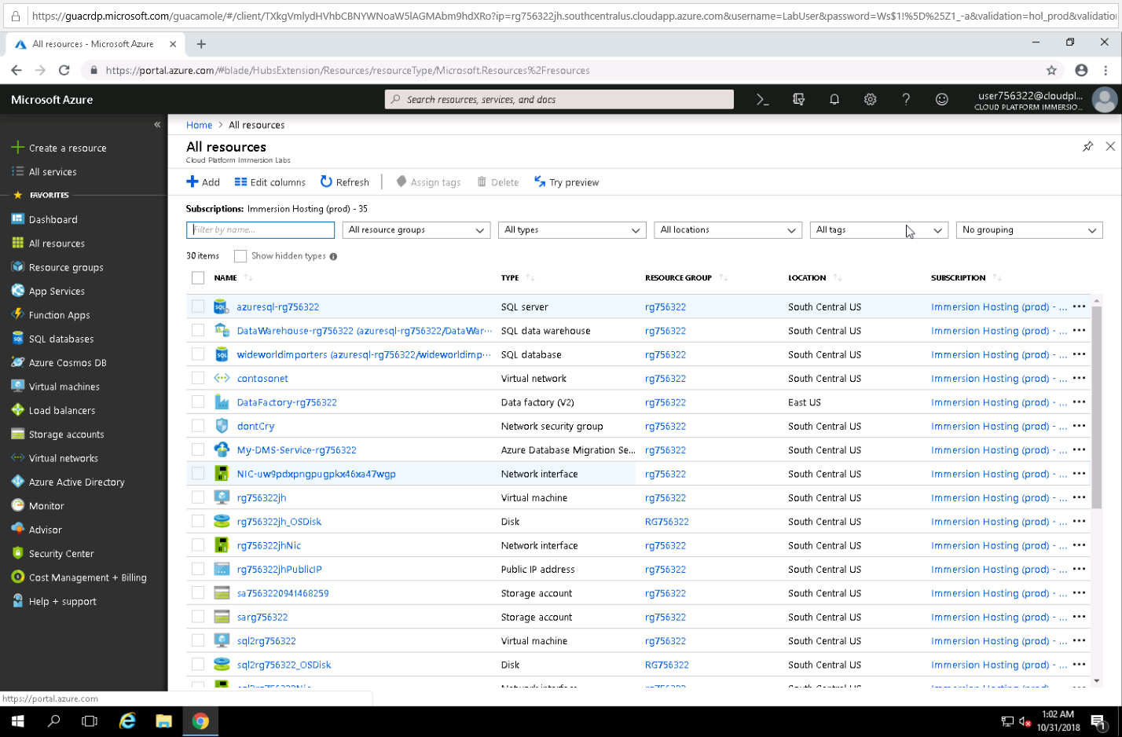
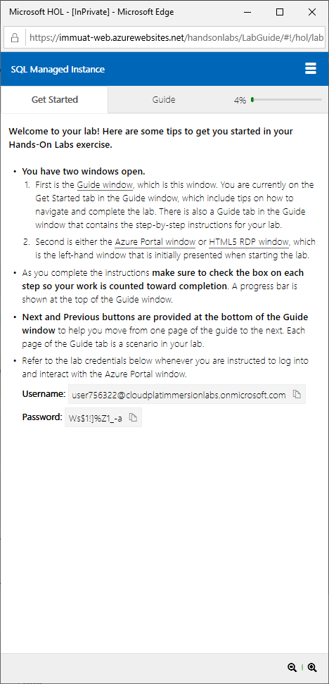
Azure SQL DB Managed Instance labs
Tiny URL: http://tinyurl.com/y86wyd6p
Use InPrivate browser
Introduction to SQL Managed Instance
Migration using SQL Managed Instance
SQL Managed Instance data integration and business intelligence

Slide 50
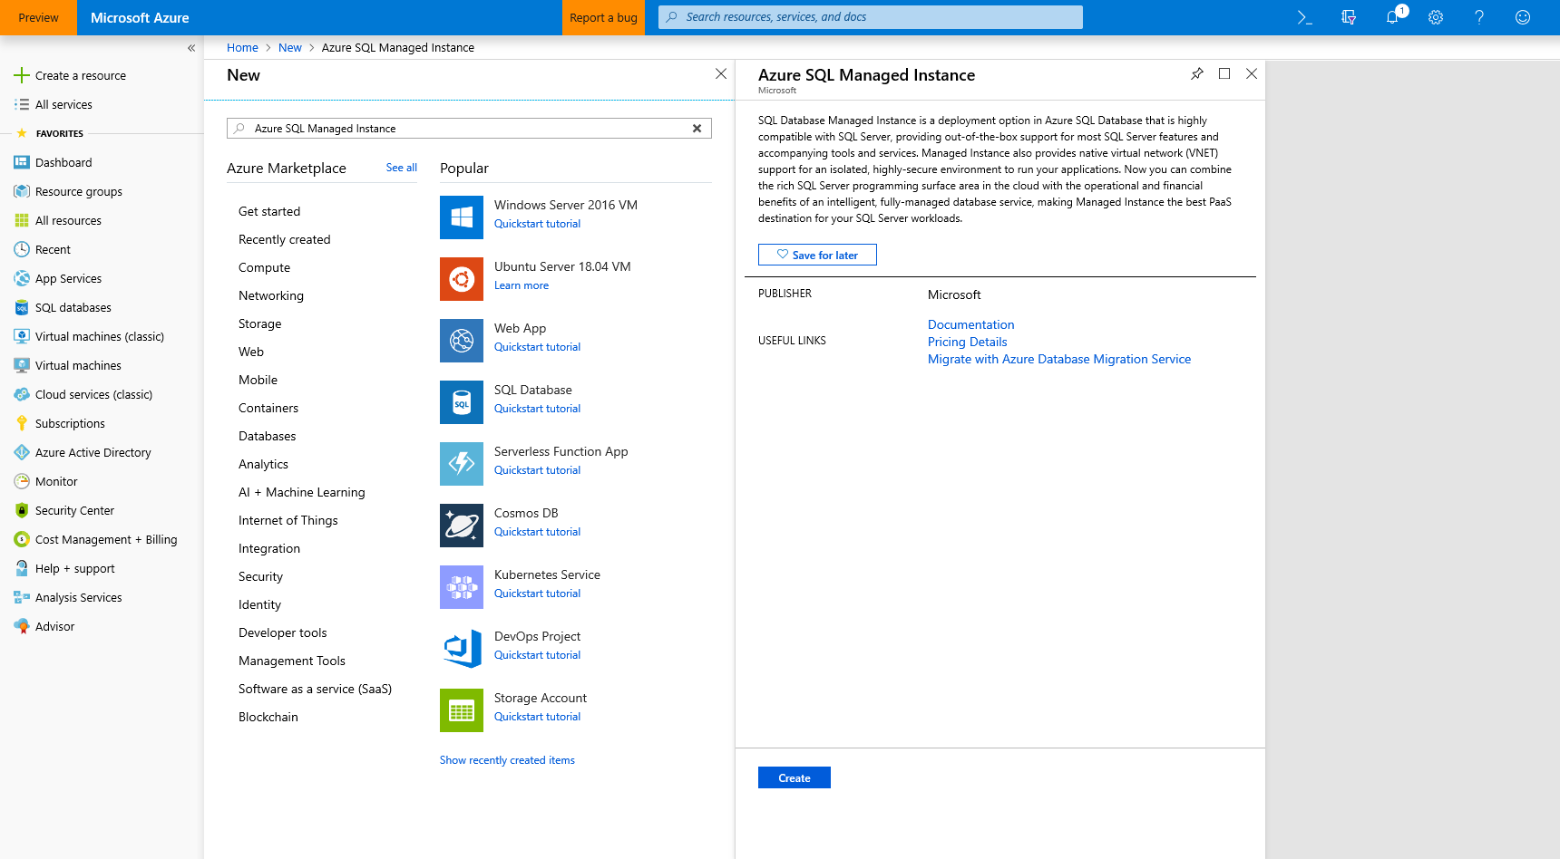
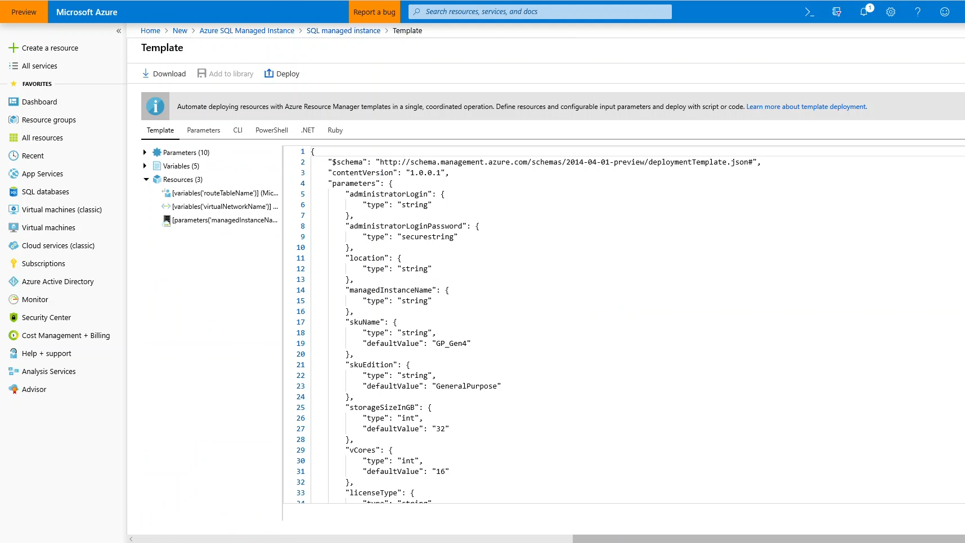
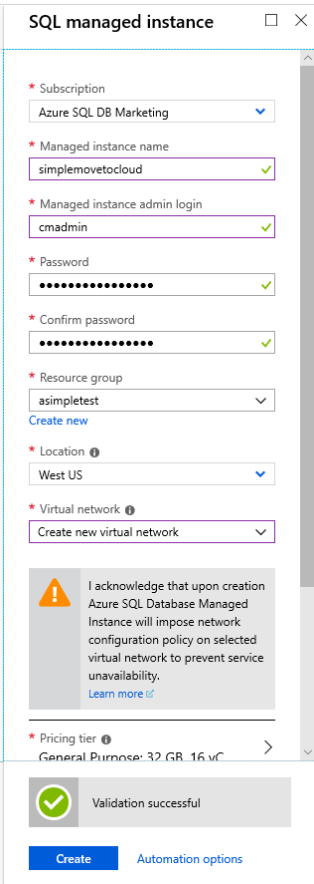
Azure SQL Database Managed Instance
Start provisioning in azure portal
Download template to automate
QuickStart walkthrough on docs
https://docs.microsoft.com/en-us/azure/sql-database/sql-database-managed-instance-get-started

Slide 51
Connecting to an Azure SQL Database Managed Instance
Driver/tool​ | Version​
.NET Framework​ | 4.6.1 (or .NET Core)​
ODBC driver​ | v17​
PHP driver​ | 5.2.0​
JDBC driver​ | 6.4.0​
Node.js driver​ | 2.1.1​
OLEDB driver​ | 18.0.2.0​
SSMS​ | 17.8.1 or higher​

Slide 52
Deployment resources
Portal Deployment walk-through
https://docs.microsoft.com/en-us/azure/sql-database/sql-database-managed-instance-create-tutorial-portal
https://docs.microsoft.com/en-us/azure/sql-database/sql-database-managed-instance-vnet-configuration
ARM Template Deployment walk-through
https://blogs.msdn.microsoft.com/sqlserverstorageengine/2018/07/02/deploy-azure-sql-managed-instance-network-environment-using-arm/
https://blogs.msdn.microsoft.com/sqlserverstorageengine/2018/05/15/creating-azure-sql-managed-instance-using-arm-templates/

Slide 53
Agenda
Intro to Azure SQL Database
Value prop, Platform benefits, TCO
Managed Instance overview
Managed Instance architecture, Features and management
Security & Networking
Security overview, Networking considerations, Hands-on-Lab
MI Features and capabilities
Key capabilities, limitations, backup & restore
Migration
Migration overview and options, Hands-on-Lab
MI & BI
Business Intelligence services + Managed Instance, Hands-on-Lab
Hyperscale
Hyperscale
Closing
Roadmap, technical resources, etc.,

Slide 54
Enterprise grade security that is easy to use
✓
✓
Trusted: most secure over last 7 years
Defense-in-depth
PHYSICAL SECURITY*
* Not in scope for this session
NETWORK SECURITY
PLATFORM SECURITY
ACCESS MANAGEMENT
THREAT PROTECTION
INFORMATION PROTECTION
CUSTOMER DATA

Slide 55
Securing the network
PHYSICAL SECURITY
NETWORK SECURITY
PLATFORM SECURITY
ACCESS MANAGEMENT
THREAT PROTECTION
INFORMATION PROTECTION
CUSTOMER DATA

Slide 56




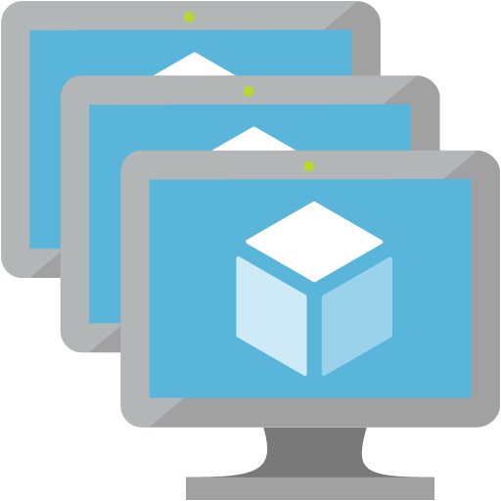

Legend:
certificate verification
Data
Management
Certificate
Certificate Authorities
Internet
Azure
VNet
TLS
TLS
Management & Deployment Plane
Azure
Azure SQL Database
Managed Instance
TLS
Service dependencies Azure
TLS
Customer applications & tools
On-Premises + Azure VNet
Maintenance
Corpnet

Slide 57






Hub & spoke architecture with Azure SQL Managed Instance
On-premises network
Hub virtual network
Spoke 1 virtual network
Workload subnet
Gateway Subnet
DMZ Subnet
NVA
vnet peering
ExpressRoute circuit
ExpressRoute Gateway
Management subnet
Management subnet
JumpBox
JumpBox
Active Directory subnet
Managed Instance subnet
Spoke 2 virtual network
Workload subnet
vnet peering
Management subnet
JumpBox

Slide 58

Host your application in the cloud or keep on-premises
SQL MI VNet
“VNet Integration”
Web app
App subnet
App Service
“VNet Integration”
Web app peered VNet
IaaS Hosted
App
App
Application VNet
MI subnet
Peering / VPN Channel
App subnet
IaaS Hosted
App
App Service
SQL Managed Instance #1
SQL Managed Instance #2
App
Express Route / VPN Gateway
On-premise app
App
Notes:
Key point(s)
You may choose to host application in the cloud either by using Azure App Service or some of Azure's virtual network (VNet) integrated options like Azure App Service Environment, Virtual Machine, Virtual Machine Scale Set. You could also take hybrid cloud approach and keep your applications on-premises.
https://docs.microsoft.com/en-us/azure/sql-database/sql-database-managed-instance-connect-app
Azure resources can communicate privately with each other through an Azure Virtual Network (VNet). A VNet is a logical isolation of the Azure cloud dedicated to your subscription.
You can implement multiple VNets within each Azure subscription and Azure region. Each VNet is isolated from other VNets.
You can connect Vnets to each other, enabling resources connected to either Vnet to communicate with each other across VNets
https://docs.microsoft.com/en-us/azure/virtual-network/virtual-networks-overview?toc=%2fazure%2fnetworking%2ftoc.json
Peering
Enables resources connected to different Azure Vnets within the same region to communicate with each other
https://docs.microsoft.com/en-us/azure/virtual-network/virtual-network-peering-overview?toc=%2fazure%2fnetworking%2ftoc.json
VPN Gateway
Enables resources connected to different Azure Vnets within different Azure region to communicate with each other
https://docs.microsoft.com/en-us/azure/vpn-gateway/vpn-gateway-howto-vnet-vnet-resource-manager-portal?toc=%2fazure%2fnetworking%2ftoc.json

Slide 59
Dedicated resources through customer isolation
VNET support in SQL Database Managed Instance
Enable full isolation from other tenants without resource sharing
Promote secure communication over private IPs with VNET integration
VNet-to-VNet
Web app (public IP)
VNet1
SQL instance #1
SQL instance #2
Network isolation (customer VNET)
Tenant isolation (compute, storage)
SQL instance #3
“Virtual data cluster” dedicated to customer (virtual private cluster, VNET, private IPs)
VPN/Express route gateway
On-premises
Notes:
SQL Database Managed Instance provides complete workload isolation of your workloads through native VNET support. We use virtual data clusters to describe the degree of isolation that customer workloads will experience with SQL Database Managed Instance. During service provisioning (on Azure Portal or through REST API), you can choose the virtual network (VNET) and the subnet to achieve full networking isolation for your Managed Instances. Once created, instances in the VNET can be reached using Azure networking mechanisms (VPN and Express Route gateways).
To two levels of isolation are provided:
Cluster (tenant ring) level: Managed Instances for a tenant are fully isolated from other tenants. No connectivity or resource sharing is possible between different tenants.
Networking level: joining instances to a subnet in a VNET and restricting access to private IP addresses only provides full isolation from public Internet.

Slide 60
Virtual network considerations
Be empty: The subnet must not contain any other cloud service associated to it, and it must not be Gateway subnet. You won’t be able to create Managed Instance in subnet that contains resources other than managed instance or add other resources inside the subnet later.
Have specific route table: The subnet must have a User Route Table (UDR) with 0.0.0.0/0 Next Hop Internet as the only route assigned to it.
Optional custom DNS: If custom DNS is specified on the VNet, Azure's recursive resolvers IP address (such as 168.63.129.16) must be added to the list.
No Service endpoint: The subnet must not have a Service endpoint (Storage or Sql) associated to it. Make sure that Service Endpoints option is Disabled when creating VNet.
Sufficient IP addresses: The subnet must have minimum of 16 IP addresses. For more information. By design, a Managed Instance needs a minimum of 16 IP addresses in a subnet and may use up to 256 IP addresses. As a result, you can use subnet masks /28 to /24 when defining your subnet IP ranges.
Azure uses five IP addresses in the subnet for its own needs
Each General Purpose instance needs two addresses
Each Business Critical instance needs four addresses
Reference docs for latest info: https://docs.microsoft.com/en-us/azure/sql-database/sql-database-managed-instance-vnet-configuration#requirements
Notes:
Be empty: The subnet must not contain any other cloud service associated to it, and it must not be Gateway subnet. You won’t be able to create Managed Instance in subnet that contains resources other than managed instance or add other resources inside the subnet later.
Have specific route table: The subnet must have a User Route Table (UDR) with 0.0.0.0/0 Next Hop Internet as the only route assigned to it.
Optional custom DNS: If custom DNS is specified on the VNet, Azure's recursive resolvers IP address (such as 168.63.129.16) must be added to the list.
No Service endpoint: The subnet must not have a Service endpoint (Storage or Sql) associated to it. Make sure that Service Endpoints option is Disabled when creating VNet.
Sufficient IP addresses: The subnet must have minimum of 16 IP addresses. For more information. By design, a Managed Instance needs a minimum of 16 IP addresses in a subnet and may use up to 256 IP addresses. As a result, you can use subnet masks /28 to /24 when defining your subnet IP ranges.
Azure uses five IP addresses in the subnet for its own needs
Each General Purpose instance needs two addresses
Each Business Critical instance needs four addresses

Slide 61
Virtual network guidance
A Managed Instance must be deployed in an Azure Virtual Network
Allows for connecting directly from an on-premises network
Allows for connecting linked servers or other on-premises data stores
Allows for connecting to additional Azure resources
Plan your deployment
Managed Instance requires a minimum of 16 IP addresses in a subnet and may use up to 256 IP addresses
If deploying multiple Managed Instances inside the subnet, you need to optimize the subnet size
The default values create a subnet that takes all the VNet address space, allowing for only Managed Instance inside the virtual network
Routes
Effective routes on the Managed Instance subnet are not supported
Routes can be user-defined (UDR) or Border Gateway Protocol (BGP) routes propagated to network interfaces through ExpressRoute or site-to-site VPN connections
For BGP routes, create a 0.0.0.0/0 Next Hop Internet route and apply it to the Managed Instance subnet
Network Security Groups (NSG)
NSGs on the Managed Instance subnet are not supported
Notes:
A Managed Instance must be deployed in an Azure Virtual Network
Allows for connecting directly from an on-premises network
Allows for connecting linked servers or other on-premises data stores
Allows for connecting to additional Azure resources
Plan your deployment
Managed Instance requires a minimum of 16 IP addresses in a subnet and may use up to 256 IP addresses
If deploying multiple Managed Instances inside the subnet, you need to optimize the subnet size
The default values create a subnet that takes all the VNet address space, allowing for only Managed Instance inside the virtual network
Routes
Effective routes on the Managed Instance subnet are not supported
Routes can be user-defined (UDR) or Border Gateway Protocol (BGP) routes propagated to network interfaces through ExpressRoute or site-to-site VPN connections
For BGP routes, create a 0.0.0.0/0 Next Hop Internet route and apply it to the Managed Instance subnet
Network Security Groups (NSG)
NSGs on the Managed Instance subnet are not supported

Slide 62
Create and configure a new Virtual Network for Managed Instance
Calculate the subnet size
Assess the needs for the rest of the Vnet
Disable Service end points
Create new ARM Virtual Network
Name | Any valid name
Address space | Any valid address range, such as 10.14.0.0/24
Subscription | Your subscription
Resource Group | Any valid resource group (new or existing)
Location | Any valid location
Subnet name | Any valid subnet name, such as mi_subnet
Subnet address range | Any valid subnet address, such as 10.14.0.0/28. Use a subnet address space smaller than the address space itself to allow space to create other subnets in the same VNet, such as a subnet for hosting test / client apps or gateway subnets to connect from on-prem or other VNets.
Service endpoints | Disabled

Slide 63
Create the required route table and associate it
Create new Route table
0.0.0.0/0 Next Hop Internet**
Associate route table with the Managed Instance subnet
Name | Any valid name
Subscription | Your subscription
Resource Group | Select the resource group you created in the previous procedure
Location | Select the location you specified in the previous procedure
Disable BCP route propagation | Enabled

Slide 64
Demo
Preparing a subnet for deployment of Managed Instance
(explain and run script)
Notes:
Log in to SQL2012DemoVM
Run scripts C:\Demo Materials\Scripts\Deployment\Validate Network.ps1

Slide 65








N-tier Architecture in Customer Data Center
Data center network
Web tier
Business tier
Data tier
Internet
Load balancer
Load balancer
Load balancer
SQL HA Cluster
Management
Active Directory
JumpBox

Slide 66





N-tier Architecture in Azure
Data center network
Web tier subnet
Business tier subnet
Managed Instance subnet
Internet
Azure application
gateway
Load balancer
Management subnet
Azure Active Directory
JumpBox

Slide 67
Demo
Securing Managed Instance with Network Security Groups
Integrating App service with MI VNET for mybadapp

Slide 68
Securing the platform
PHYSICAL SECURITY
Enhanced monitoring
Collecting of low-fidelity anomalous activity
Monitoring PERF for traits
Red Team / Blue Team
NETWORK SECURITY
PLATFORM SECURITY
ACCESS MANAGEMENT
THREAT PROTECTION
INFORMATION PROTECTION
CUSTOMER DATA

Slide 69
Virtual cluster
VNet
Virtual cluster
SQL
Node
GW
primary node
mymi.<clusterid>.database.windows.net
TLS
ILB
Node
GW
Windows Firewall
TDS endpoint
(Private IP)
Node
SQL
Engine
TLS
SQL Management
Node Agent
TLS
LB
GW
SQL Management (Public IP)
SQL Management (public IP)
TDS endpoint (private IP)
Notes:
We assume breach…
Enhanced monitoring of our Azure Assets
Collection of low-fidelity anomalous activity (automated hunting)
Monitoring PERF for traits of crypto currency mining
… and large set of other detections that we don’t talk about publicly
Attack team, SQL Red Team, tries to get in, gain a foothold, escalate privileges, and maintain persistence
SQL Blue Team practices defense-in-depth
When we detect something, e.g., failed login attempts, we defend…
If it involves customer, we will notify
Many times this is the customer’s own security and compliance scanners!

Slide 70
Platform/Service Security
We assume breach…
Enhanced monitoring of our Azure Assets
Collection of low-fidelity anomalous activity (automated hunting)
Monitoring PERF for traits of crypto currency mining
… and large set of other detections that we don’t talk about publicly
Attack team, SQL Red Team, tries to get in, gain a foothold, escalate privileges, and maintain persistence
SQL Blue Team practices defense-in-depth
When we detect something, e.g., failed login attempts, we defend…
If it involves customer, we will notify
Many times this is the customer’s own security and compliance scanners!

Slide 71
Configuring authentication
PHYSICAL SECURITY
Azure Active Directory
Provides an alternative to SQL authentication.
Helps to stop the proliferation of user identities across Azure SQL logical servers and SQL DBs
Use benefits provided by Azure AD
NETWORK SECURITY
PLATFORM SECURITY
ACCESS MANAGEMENT
THREAT PROTECTION
INFORMATION PROTECTION
CUSTOMER DATA
Notes:
Provides an alternative to SQL authentication.
Helps to stop the proliferation of user identities across Azure SQL logical servers and SQL DBs
Use benefits provided by Azure AD (e.g., supports new user accounts, or enables password rotation)
Central permission management for:
Individual users
Groups
External/guest users with and w/o Azure AD access
Integrated Windows auth and single sign-on
Universal/Interactive auth w/o hard-coded passwords
Use of Managed Service Instance for VMs and Windows certificates
Supports: Interactive Multi-factor authentication (MFA) Users w/o hard coded password (interactive) Federated accounts Guest accounts (B2B)
Azure AD Conditional Access for configuring domain accounts for MFA
Can impose MFA without asking domain administrator to make global change
SSMS (since 17.1+)
B2B requires SSMS 17.4+
SQL Package
Import/Export
SSDT (in preview)
SQLCMD, BCP (soon)
Drivers:
.NET 4.7.2 (in preview)
ODBC 17.1, JDBC, … (soon)

Slide 72
Azure Active Directory Authentication
Central ID Management
Simplified Permission Management
Can help you Eliminate Storing Passwords
With support for Multi-factor authentication
Universal / Interactive Authentication
Flexible Configuration
Supported in many Tools and Drivers
Notes:
Provides an alternative to SQL authentication.
Helps to stop the proliferation of user identities across Azure SQL logical servers and SQL DBs
Use benefits provided by Azure AD (e.g., supports new user accounts, or enables password rotation)
Central permission management for:
Individual users
Groups
External/guest users with and w/o Azure AD access
Integrated Windows auth and single sign-on
Universal/Interactive auth w/o hard-coded passwords
Use of Managed Service Instance for VMs and Windows certificates
Supports: Interactive Multi-factor authentication (MFA) Users w/o hard coded password (interactive) Federated accounts Guest accounts (B2B)
Azure AD Conditional Access for configuring domain accounts for MFA
Can impose MFA without asking domain administrator to make global change
SSMS (since 17.1+)
B2B requires SSMS 17.4+
SQL Package
Import/Export
SSDT (in preview)
SQLCMD, BCP (soon)
Drivers:
.NET 4.7.2 (in preview)
ODBC 17.1, JDBC, … (soon)

Slide 73
Other Capabilities
Row-level security
Data Discovery & Classification
(very early prototype in preview for Azure SQL Database Singletons/Pools)
Data Masking (dynamic, static in private preview)

Slide 74
Demo
Azure Active Directory Integrated Authentication
Support for
B2B,
MFA through conditional access policies,
AAD-based logins
RLS demo on public endpoint
Notes:
Log in to sqldbpmdemo1 (Managed Instance) FROM SQL2012DemoVM using xxxxx@microsoft.com

Slide 75
Monitoring and auditing
SQL Auditing
Integration with Log Analytics and Event Hubs for SQL DB
Singletons/pools (coming to M.I. soon)
Advanced Threat Protection
Vulnerability Assessment
Threat Monitoring (3 classes of threats)
PHYSICAL SECURITY
NETWORK SECURITY
PLATFORM SECURITY
ACCESS MANAGEMENT
THREAT PROTECTION
INFORMATION PROTECTION
CUSTOMER DATA
Notes:
SQL Auditing
Integration with Log Analytics and Event Hubs for SQL DB singletons/pools (coming to M.I. soon)
Advanced Threat Protection
Vulnerability Assessment
Threat Monitoring (3 classes of threats)

Slide 76
Threat Protection
SQL Auditing
Integration with Log Analytics and Event Hubs for SQL DB singletons/pools (coming to M.I. soon)
Advanced Threat Protection
Vulnerability Assessment
Threat Monitoring (3 classes of threats)

Slide 77
Demo
Threat Detection
Notes:
Need to figure out Vulnerability Assessment. Otherwise drop that part.
View Threat Detection blade in Portal for ATP settings. Browse to
MyBadWebsitevnet.azurewebsites.net

Slide 78
Protecting the data
PHYSICAL SECURITY
Encryption-in-flight
(aka. Transport Layer Security TLS)
Encryption-at-rest
(aka. Transparent Data Encryption TDE) Service- or User-managed keys Backup encryption
Encryption-in-use (Always Encrypted)*
Key management with Azure Key Vault
NETWORK SECURITY
PLATFORM SECURITY
ACCESS MANAGEMENT
THREAT PROTECTION
INFORMATION PROTECTION
CUSTOMER DATA

Slide 79
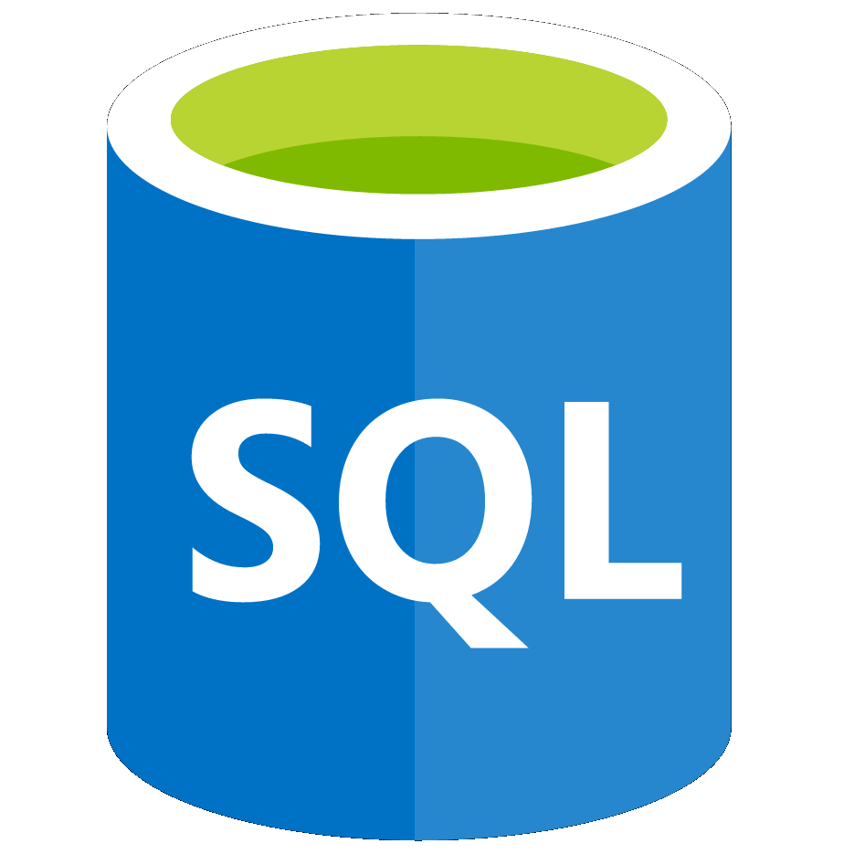
Encryption
Encryption-in-flight
(aka Transport Layer Security TLS)
Encryption-at-rest
(aka Transparent Data Encryption TDE)
Service- or User-managed keys
Backup encryption
Encryption-in-use (Always Encrypted) *
Key management with Azure Key Vault
Customer
Data
Data Protection

Slide 80
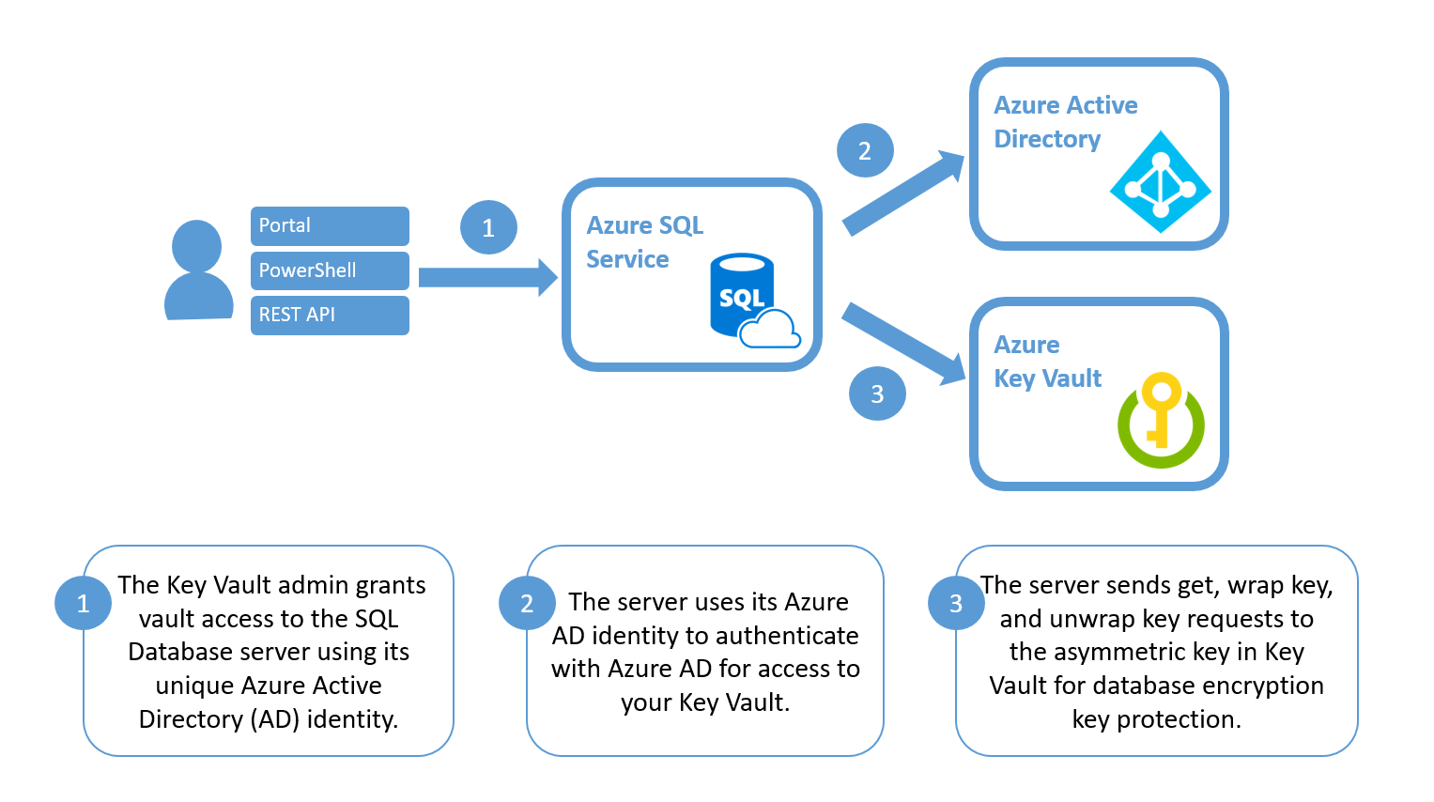
TDE with Azure Key Vault
COMING SOON
GA
Released
May ‘18
Assume more control over who has access to your data and when
Highly available and scalable cloud-based key store
Central key management that allows separation of key management and data
Enabled via Azure Portal, PowerShell and REST API
https://docs.microsoft.com/en-us/sql/relational-databases/security/encryption/transparent-data-encryption-byok-azure-sql
Notes:
Bring Your Own Key (BYOK) support for Transparent Data Encryption (TDE) allows you to encrypt the Database Encryption Key (DEK) with an asymmetric key called TDE Protector. The TDE Protector is stored under your control in Azure Key Vault, Azure’s cloud-based external key management system. Azure Key Vault is the first key management service with which TDE has integrated support for BYOK. The TDE DEK, which is stored on the boot page of a database is encrypted and decrypted by the TDE protector. The TDE Protector is stored in Azure Key Vault and never leaves the key vault.
TDE with BYOK provides the following benefits:
Increased transparency and granular control with the ability to self-manage the TDE protector
Central management of TDE protectors (along with other keys and secrets used in other Azure services) by hosting them in Key Vault
Separation of key and data management responsibilities within the organization, to support separation of duties
Greater trust from your own clients, since Key Vault is designed so that Microsoft does not see or extract any encryption keys.
Support for key rotation

Slide 81
Demo
Restoring a TDE-encrypted database
Customer managed keys

Slide 82






Demo Architecture
Internet
On-premises
Azure
Azure Resources
Single VNET – Two Subnets
Jumpbox in Separate Subnet
radneyblob
radneyblob
radneytest
PowerBI
aldormeaas
VNET – myvnet – 192.168.0.0/16
v
subnet – myvnet/default - 192.168.2.0/24
subnet – myvnet/Tim - 192.168.3.0/24
Virtual data cluster
aldormevm
BC
GP
aldormebcdemo
tradnew
Data Gateway
MSSQLSERVER
aldormedms

Slide 83
Agenda
Intro to Azure SQL Database
Value prop, Platform benefits, TCO
Managed Instance overview
Managed Instance architecture, Features and management
Security & Networking
Security overview, Networking considerations, Hands-on-Lab
MI Features and capabilities
Key capabilities, limitations, backup & restore
Migration
Migration overview and options, Hands-on-Lab
MI & BI
Business Intelligence services + Managed Instance, Hands-on-Lab
Hyperscale
Hyperscale
Closing
Roadmap, technical resources, etc.,

Slide 84



Authentication
On-premises / Private cloud
Azure SQL Database
Azure Active Directory
Active Directory
ADALSQL
Application
SSMS
SSDT
Connection string-based authentication
SQL package
ADO.NET 4.6
Notes:
ADALSQL = Active Directory Authentication Library for SQL server
Reference links:
https://docs.microsoft.com/en-us/azure/sql-database/sql-database-aad-authentication
https://docs.microsoft.com/en-us/azure/sql-database/sql-database-aad-authentication-configure
https://docs.microsoft.com/en-us/dotnet/framework/data/adonet/ado-net-overview

Slide 85
General Purpose
Feature | Description
Number of vCores* | 8, 16, 24 (Gen 4) 8, 16, 24, 32, 40, 64, 80 (Gen 5)
SQL Server version / build | SQL Server (latest available)
Min storage size | 32 GB
Max storage size | 8 TB
Max storage per database | Determined by the max storage size per instance
Expected storage IOPS | 500-7500 IOPS per data file (depends on data file). See Premium Storage
Number of data files (ROWS) per the database | Multiple
Number of log files (LOG) per database | 1
Managed automated backups | Yes
HA | Based on remote storage and Azure Service Fabric
Built-in instance and database monitoring and metrics | Yes
Automatic software patching | Yes
VNet - Azure Resource Manager deployment | Yes
VNet - Classic deployment model | No
Portal support | Yes
Redundant nodes
Azure storage accounts
Active compute nodes

Slide 86
Business Critical
Primary endpoint
(read-write)
Read-only endpoint
Feature | Description
Number of vCores* | 8, 16, 24, 32 (Gen 4) 8, 16, 24, 32, 40, 64, 80 (Gen 5)
SQL Server version / build | SQL Server (latest available)
Additional features | In-Memory OLTP 1 additional read-only replica (Read Scale-Out)
Min storage size | 32 GB
Max storage size | Gen 4: 1 TB (all vCore sizes Gen 5:1 TB for 8, 16 vCores 2 TB for 24 vCores 4 TB for 32, 40, 64, 80 vCores
Max storage per database | Determined by the max storage size per instance
Number of data files (ROWS) per the database | Multiple
Number of log files (LOG) per database | 1
Managed automated backups | Yes
HA | Based on Always On Availability Groups and Azure Service Fabric
Built-in instance and database monitoring and metrics | Yes
Automatic software patching | Yes
VNet - Azure Resource Manager deployment | Yes
VNet - Classic deployment model | No
Portal support | Yes
Always On AG
SQL
Super-fast SSD
SQL
Primary replica
Secondary replica
SQL
SQL
Secondary replica
Secondary replica
Business Critical service tier: collocated compute and storage

Slide 87
Built-in high availability
Single logical database
DB
High Availability is handled behind the scenes automatically
For General Purpose there is a four-node Availability Group
The secondary is non-readable
For Business Critical there is a three-node Availability Group
One secondary is readable, and the other is non-readable (Application Intent = ReadOnly)
An on-prem SQL Server Availability Group cannot be extended to a Managed Instance
Logical
Availability group
Ack
value
Read
write
Seamless and Transparent
P
Ack
Write
S
Write
Ack
S
Physical
Reads are completed at the primary
Writes are replicated to secondaries

Slide 88
Surface area of Managed Instance
MI is always on latest and greatest SQL engine version
Certify your code for database compatibility level not for a version
Take advantage of new features (Temporal, JSON, Graph Database, etc.)
Use rich T-SQL surface area, check out documentation page
Your code can be SQL deployment model aware if necessary
SERVERPROPERTY (‘EngineEdition’) = 8 uniquely identifies MI
Current limitations (will be removed later this year)
Time is UTC . Use AT TIME ZONE to add local time zone experience
Instance collation is fixed (affects tempdb and system databases)
Always on the latest and greatest SQL engine version
Your code can be SQL deployment model aware if necessary
Note: current limitation being removed later this year
Notes:
MI is always on latest and greatest SQL engine version
Certify your code for database compatibility level not for a version
Take advantage of new features (Temporal, JSON, Graph Database, etc.)
Use rich T-SQL surface area, check out documentation page
Your code can be SQL deployment model aware if necessary
SERVERPROPERTY (‘EngineEdition’) = 8 uniquely identifies MI
Current limitations (will be removed later this year)
Time is UTC . Use AT TIME ZONE to add local time zone experience
Instance collation is fixed (affects tempdb and system databases)

Slide 89
Database Compatibility Based Certification
Microsoft Database Compatibility Level Protection
Full Functional protection once assessment tool runs clean.
Maintaining backward compatibility is very important to SQL Server team.
Query Plan shape protection.
Overall process
Use Database Migration Assistant (DMA) and Database Experimentation Assistant (DEA) for assessment.
Migrate database and keep/set source Database Compatibility Level on target.
Perform minimal testing or as determined by your organization.
Contact Microsoft
Explore jointly on how to use Database Compatibility based certification.
Microsoft database compatibility level protection
Easy to use tools to help you access migration
Notes:
Microsoft Database Compatibility Level Protection
Full Functional protection once assessment tool runs clean.
Maintaining backward compatibility is very important to SQL Server team.
Query Plan shape protection.
Overall process
Use Database Migration Assistant (DMA) and Database Experimentation Assistant (DEA) for assessment.
Migrate database and keep/set source Database Compatibility Level on target.
Perform minimal testing or as determined by your organization.
Contact Microsoft – Explore jointly on how to use Database Compatibility based certification.

Slide 90
App compatibility: what’s is missing?
Features with a better alternative in Azure
Always-On Availability Groups: local HA, active geo-replication
Windows Authentication: Azure Active Directory is the alternative.
Management Data Warehouse : OMS integration is the alternative.
Retired features
Database Mirroring: built-in HA / geo-replication
Extended stored procedures: customers should use CLR
Features considered post-GA
Filestream, Filetable
Cross-instance distributed transactions (MS DTC)
Stretch Database
PolyBase
Notes:
Features with a better alternative in Azure
Always-On Availability Groups: local HA, active geo-replication
Windows Authentication: Azure Active Directory is the alternative.
Management Data Warehouse : OMS integration is the alternative.
Retired features
Database Mirroring: built-in HA / geo-replication
Extended stored procedures: customers should use CLR
Features considered post-GA
Filestream, Filetable
Cross-instance distributed transactions (MS DTC)
Stretch Database
PolyBase

Slide 91
Azure AD
Provides an alternative to SQL Server authentication so database permissions can be managed via external (Azure AD) groups
Supports:
Token-based authentication for applications connecting to SQL Database
ADFS or native user/password authentication for a local Azure Active Directory without domain synchronization
Multi-Factor Authentication (MFA)
Windows logins are not supported
CREATE LOGIN... FROM WINDOWS is not permitted
SQL logins are fully supported when created using:
FROM CERTIFICATE
FROM ASYMMETRIC KEY,
FROM SID
Azure AD user who creates the Managed Instance has unrestricted administrative privileges by default
This can be changed from an individual to a security group account
Azure AD non-admin database users can be created using CREATE USER… FROM EXTERNAL PROVIDER syntax

Slide 92
CLR Considerations
Managed Instance cannot access file shares and Windows folders
Only CREATE ASSEMBLY FROM BINARY is supported
CREATE ASSEMBLY FROM FILE is not supported
ALTER ASSEMBLY can’t reference files

Slide 93
SQL Server Agent
Built into Managed Instance
Azure SQL Database requires using on-premises SQL Server Agent, Azure Automation, Elastic Jobs, or PowerShell
Always running
Services cannot be stopped or restarted like they can with on-premises
Option to auto-restart SQL Server if it stops unexpectedly is disabled
Option to auto-restart SQL Server Agent if it stops unexpectedly is disabled
Forwarding SQL Server events is disabled
On-premises SQL Server Agent allows for forwarding events to another server but this is currently not an option for a Managed Instance
Connection
Alias local host server is predefined for a Managed Instance, whereas on-premises SQL Server Agent allows that to be configured if needed
Creating jobs
Creating jobs is as simple and easy as on-premises
Jobs can be created using the UI or T-SQL
Alert System
Functions the same as on-premises for sending email alerts
SQLCMD
Cannot be called within a SQL Server Agent job
Can be used to connect to a Managed Instance

Slide 94
Service broker within instances
Service broker is on by default for all user databases
Cross-instance service broker is not supported
CREATE ROUTE does not work with ADDRESS other than LOCAL
ALTER ROUTE does not work with ADDRESS other than LOCAL

Slide 95
Database mail
Fully supported in Managed Instance
Functions the same as on-premises to set up and use
Azure SQL Database does not have Database Mail support

Slide 96
Replication support
Supported
Snapshot replication. Same functionality as on-premises
Transactional replication
Unsupported
Peer-to-peer replication
Merge replication
Heterogeneous replication
Oracle publisher
For comparison, Azure SQL Database only supports being a transactional replication push subscriber
Some restrictions when used with a Managed Instance
Updatable subscriptions are not permitted
Publisher and distributor must be in the same location
If publisher and distributor are in a Managed Instance, Azure file share must be used to store data and schema from the publication
Connections to the Distributor must use SQL authentication
Additions to support Managed Instance
New fields have been added in replication-related tables in msdb
job_login, job_password, storage_connection_string
SSMS replication wizard supports using a Managed Instance

Slide 97
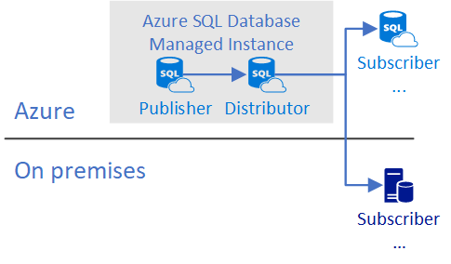
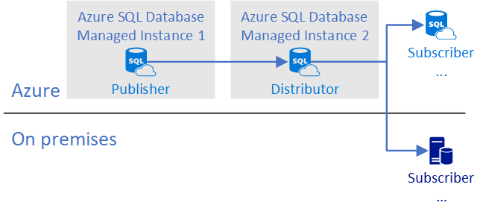
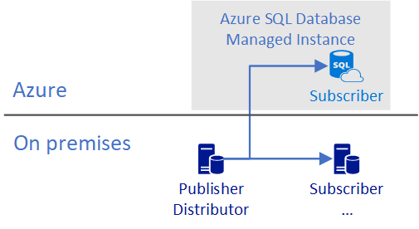
Publisher with Local Distributor on MI
Publisher with Remote Distributor on MI
Publisher and distributor on-premises with subscriber on managed instance

Slide 98
Database Compatibility Based Certification
Microsoft Database Compatibility Level Protection
Full Functional protection once assessment tool runs clean.
Maintaining backward compatibility is very important to SQL Server team.
Query Plan shape protection.
Overall process
Use Database Migration Assistant (DMA) and Database Experimentation Assistant (DEA) for assessment.
Migrate database and keep/set source Database Compatibility Level on target.
Perform minimal testing or as determined by your organization.
Microsoft database compatibility level protection
Easy to use tools to help you access migration
Notes:
Microsoft Database Compatibility Level Protection
Full Functional protection once assessment tool runs clean.
Maintaining backward compatibility is very important to SQL Server team.
Query Plan shape protection.
Overall process
Use Database Migration Assistant (DMA) and Database Experimentation Assistant (DEA) for assessment.
Migrate database and keep/set source Database Compatibility Level on target.
Perform minimal testing or as determined by your organization.
Contact Microsoft – Explore jointly on how to use Database Compatibility based certification.

Slide 99
App compatibility: what’s is missing?
Features with a better alternative in Azure
Always-On Availability Groups: local HA, active geo-replication
Windows Authentication: Azure Active Directory is the alternative.
Management Data Warehouse : OMS integration is the alternative.
Retired features
Database Mirroring: built-in HA / geo-replication
Extended stored procedures: customers should use CLR
Features considered post-GA
Filestream, Filetable
Cross-instance distributed transactions (MS DTC)
Stretch Database
PolyBase
Notes:
Features with a better alternative in Azure
Always-On Availability Groups: local HA, active geo-replication
Windows Authentication: Azure Active Directory is the alternative.
Management Data Warehouse : OMS integration is the alternative.
Retired features
Database Mirroring: built-in HA / geo-replication
Extended stored procedures: customers should use CLR
Features considered post-GA
Filestream, Filetable
Cross-instance distributed transactions (MS DTC)
Stretch Database
PolyBase

Slide 100
Connecting to Managed instance
Jumpbox creation and consideration
SSMS – VPN/Express Route
Application
VNet-to-VNet
Web app (public IP)
VNet1
SQL instance #1
SQL instance #2
Network isolation (customer VNET)
Tenant isolation (compute, storage)
SQL instance #3
Driver/tool | Version
.NET Framework | 4.6.1 (or .NET Core)
ODBC driver | v17
PHP driver | 5.2.0
JDBC driver | 6.4.0
Node.js driver | 2.1.1
OLEDB driver | 18.0.2.0
SSMS | 17.8.1 or higher
“Virtual data cluster” dedicated to customer (virtual private cluster, VNET, private IPs)
VPN/Express route gateway
On-premises

Slide 101
User Database File Layout Considerations
Data file default initial size is 16MB with 16MB auto growth
These can and should be adjusted for your workload
File size limit is 8TB in General Purpose
Log file default initial size is 8MB with 16MB auto growth
This can and should be adjusted for your workload
Additional data files/filegroups can be added
Only using an ALTER DATABASE statement and the FILENAME clause is not permitted
Paths and File Names are chosen for you
Different from Azure SQL Database where additional files are not allowed
Multiple log files are not supported (and should not be needed)
A backup with multiple files/filegroups can be restored
Each user database has a FILESTREAM filegroup for In-Memory OLTP checkpoint files
Multiple log files are not supported (and should not be needed)

Slide 102
Tempdb Data File Considerations
Tempdb Tuning Options
Multiple tempdb data files are created automatically
Default data file and log file sizes are 16MB
These can and should be adjusted for your workload
Default auto-growth for data files is set to 256MB
This can be adjusted for your workload if needed
Default auto-growth for the log file is set to 64MB
This can be adjusted for your workload if needed
Additional tempdb data files can be created if needed
Files can only be created using an ALTER DATABASE statement and the FILENAME clause is not permitted
Well-known tempdb tuning ‘fixes’ are on by default
Data files auto-grow at the same time
Single-page allocations disabled
This default behavior was introduced in SQL Server 2016 for on-premises
Tempdb Resizing
Sometimes necessary to resize tempdb after excessive growth
E.g. from a runaway query with a large memory spill to tempdb
The SQL Server Service cannot be restarted manually to make tempdb resize back to the configured size
This is the usual way of dealing with the situation in on-premises
It is possible to shrink the database or shrink one or more files if needed
Be aware that just as with on-premises, tempdb shrinking may not be able to progress if it encounters certain data page types
This is usually solved on-premises by restarting the instance
A better option may be to restrict tempdb from growing out of control by specifying a maximum file size

Slide 103
Backup/restore

Slide 104
Backups are automatic
Database backup schedule is the same as Azure SQL Database
Full database backups occur weekly
Differential backups generally happen every few hours
Transaction log backups generally happen every 5‒10 minutes
Frequency is based upon performance level and amount of database activity
COPY_ONLY, URL-based backups can be used to perform manual full database backups
Not available on Azure SQL Database
Backup retention is 7 days by default
Configurable up to 35 days for General Purpose and Business Critical

Slide 105
Restore considerations
Point-in-time restores are possible and must be performed manually using the Azure Portal
Restoring automated backups from within SSMS is not allowed
You can only restore using the Azure Portal
COPY_ONLY, URL-based full backups can be restored using SSMS to a Managed Instance only
Cannot be restored to on-premises as Managed Instance uses a higher build than on-premises instances
Databases with multiple log files cannot be restored
Secondary log files must be removed prior to backing up and restoring to a Managed Instance
Can restore backups in a specific DB Compatibility
Supports up to SQL 2005

Slide 106
What to remember when migrate
Latest driver versions provides best connectivity experience
MI is PaaS - build connectivity resilience into your code to protect from transient faults
Well-known SSMS tools supported – install latest version
MI is always on latest and greatest SQL engine version but supports db compat levels from 100 and above
Code can be MI aware, if necessary: SERVERPROPERTY (‘EngineEdition’) = 8
Current limitations (will be removed later this year)
Time is UTC . Use AT TIME ZONE to add local time zone experience
Instance collation is fixed (affects tempdb and system databases)
You can use read-only replicas to load balance read-only queries
Local and Geo-DR

Slide 107
What to remember when migrate
Latest driver versions provides best connectivity experience
MI is PaaS ‒ build connectivity resilience into your code to protect from transient faults
Well-known SSMS tools supported – install latest version
MI is always on latest and greatest SQL engine version but supports db compat levels from 100 and above
Code can be MI aware, if necessary: SERVERPROPERTY (‘EngineEdition’) = 8
Current limitations (will be removed later this year)
Time is UTC. Use AT TIME ZONE to add local time zone experience
Instance collation is fixed (affects tempdb & system databases)
You can use read-only replicas to load balance read-only queries
Local and Geo-DR

Slide 108
Azure Database Migration Service
Self-guided migration process
Provides comprehensive assessments for pre-migration
Allows for migration at scale from multiple sources to the target database with minimal downtime
Requires an active Azure subscription and site-to-site connectivity
Roadmap to support large amount of sources
Convergence of DMA functionality and DMS
Integration with Azure Databox

Slide 109
Data Migration Assistant
Provides any recommendations and alternative approaches available in Azure prior to migrating
Categorized as performance, security, or storage
Identifies blocking issues: compatibility issues that block migrating on-premises SQL Server database(s) to Azure SQL Database(s)
Detects partially supported or unsupported features that are in use on the source SQL Server instance
Compatibility issues are categorized as breaking changes, behavior changes, or deprecated features
Can migrate databases schemas, data, users, logins, server roles
Data Migration Assistant behavior
Feature recommendations are categorized as:
Performance
Security
Storage
Migration components include:
Schema of databases
Data and users
Server roles
Logins

Slide 110
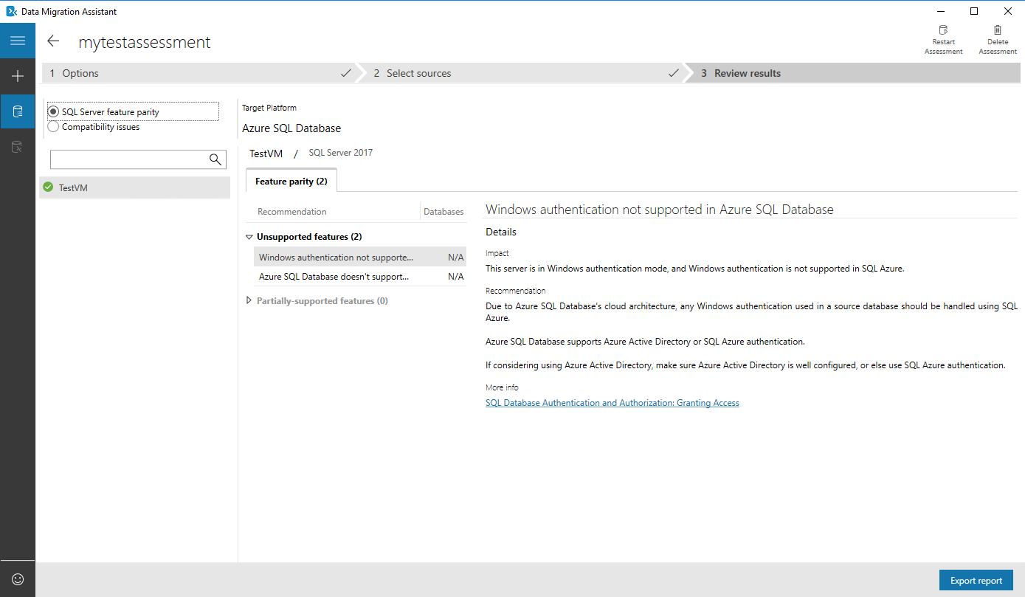
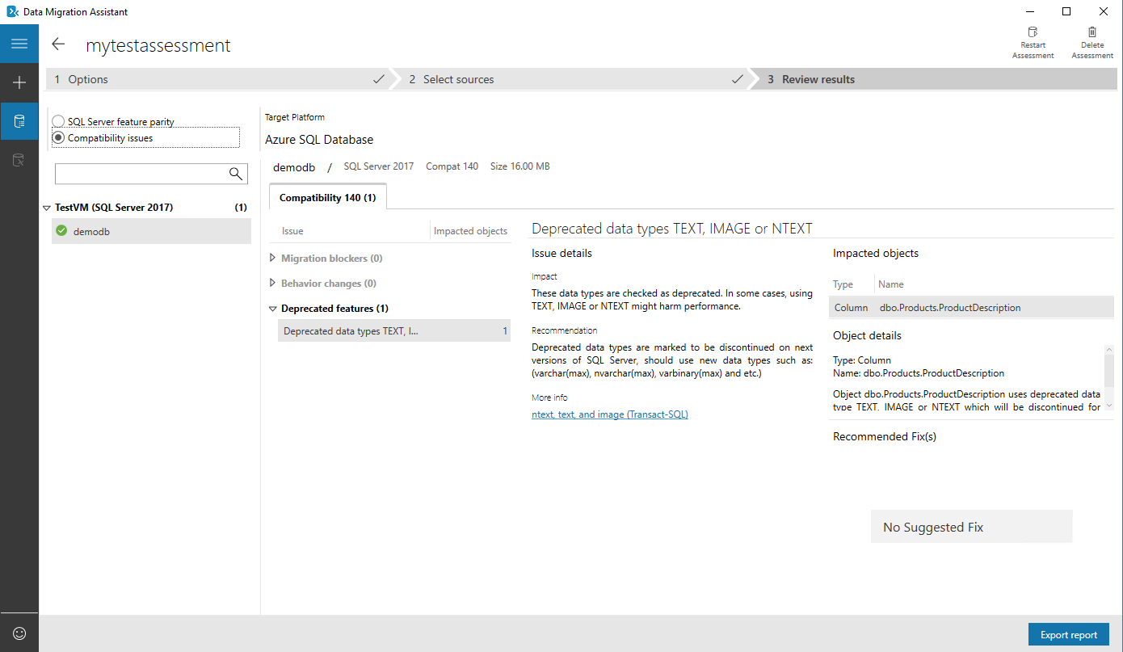
Data Migration Assistant
Assess on-premises SQL Server instance(s) for migrating to Azure SQL database(s)
Discover issues that can affect an upgrade
Migrate an on-premises SQL Server instance to a modern SQL Server instance

Slide 111
Agenda
Intro to Azure SQL Database
Value prop, Platform benefits, TCO
Managed Instance overview
Managed Instance architecture, Features and management
Security & Networking
Security overview, Networking considerations, Hands-on-Lab
MI Features and capabilities
Key capabilities, limitations, backup & restore
Migration
Migration overview and options, Hands-on-Lab
MI & BI
Business Intelligence services + Managed Instance, Hands-on-Lab
Hyperscale
Hyperscale
Closing
Roadmap, technical resources, etc.,

Slide 112
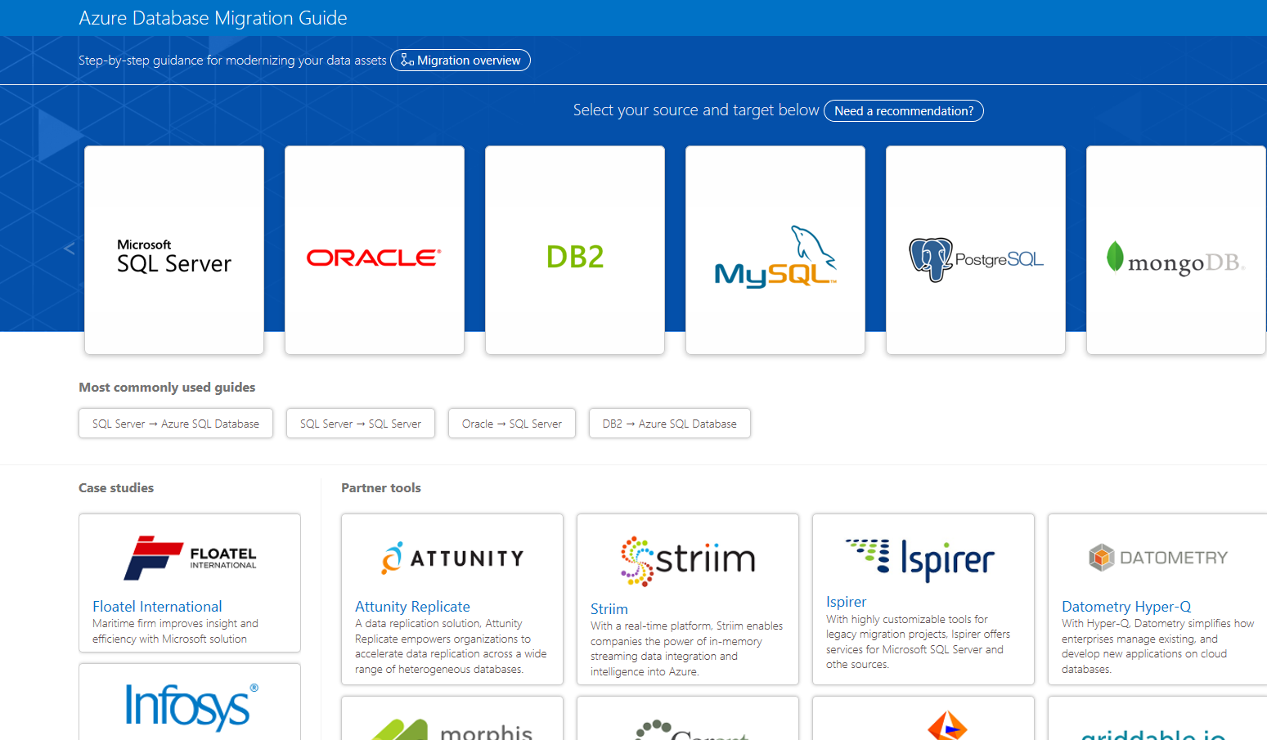
Azure database migration guide
Step-by-step guidance for modernizing your data assets
https://datamigration.microsoft.com/
Notes:
Navigate to website and show experience
https://datamigration.microsoft.com/

Slide 113
Azure Database migration journey
Assess
Migrate
Optimize
Notes:
Assess
When the data sources have been identified, the next step is to assess on-premises SQL Server instance(s) migrating to Azure SQL database(s) to understand the gaps between the source and target instances. Use the Data Migration Assistant (DMA) to assess your source database before migrating to Azure SQL Database.
Migrate
After you have the necessary prerequisites in place and have completed the tasks associated with the Pre-migration phase, you are ready to perform the schema and data migration.
Optimize
After you have successfully completed the Migration phase, you need to go through a series of post-migration tasks to ensure that everything is functioning as smoothly and efficiently as possible.
The post migration phase is crucial for reconciling any issues with data accuracy and completeness, as well as addressing potential performance issues with the workload.

Slide 114
Azure Database migration journey
SQL
Managed Instance
*
Migrate
Rehost
(lift and shift)
Enables optimization during or post migration (fully managed service)
Enables rehosting or light refactoring for most apps
Refactor
Rearchitect
Assess
Migrate
Optimize
Eliminates the need
to rearchitect or
rebuild your apps
Rebuild
IaaS (virtual machines) fall short here
* These migration strategies are adopted from Gartner research. Gartner also calls out a 5th strategy called “Replace,” which is all about SaaS. We won’t focus on that here.
Notes:
Rehost & refactor are the by far the simplest way to migrate and can be seamless.
Obviously, Rearchitecting and rebuilding can take considerable effort and time.

Slide 115
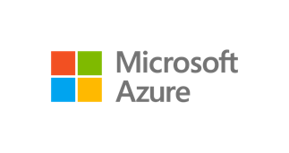

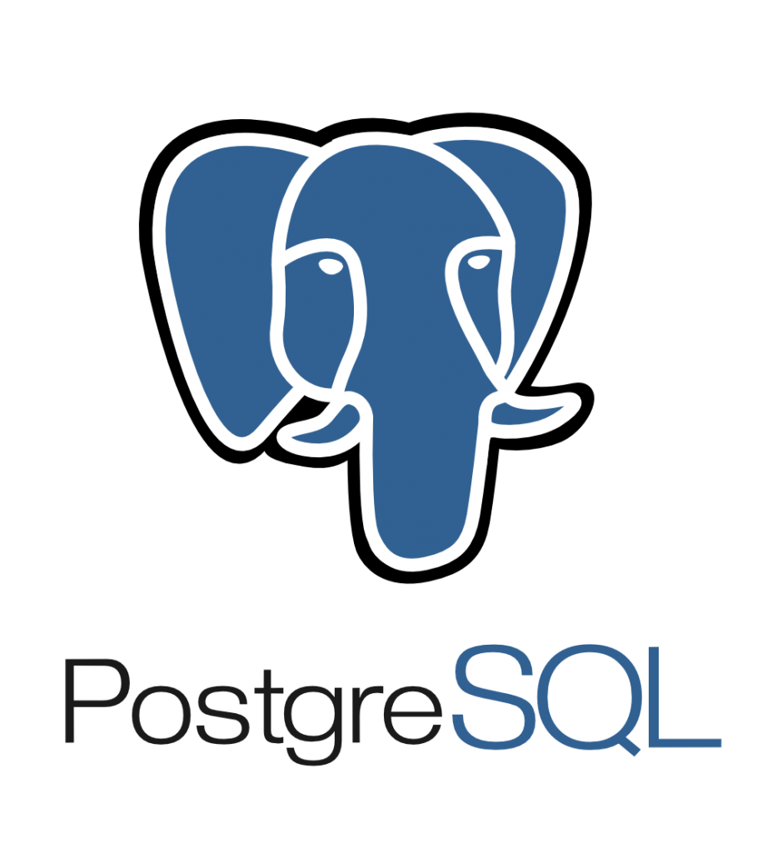

Migrating databases using Azure Database Migration Services
On-premises
SQL
SQL
SQL Server 2005 - 2017
MY
Assessment
SSMA & DMA
Azure Database Migration Service
Cosmos DB
Seamless, end to end solution | Near-zero downtime | Resilient | Migrate at-scale from multiple sources

Slide 117
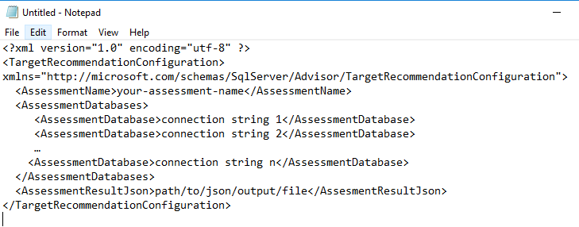
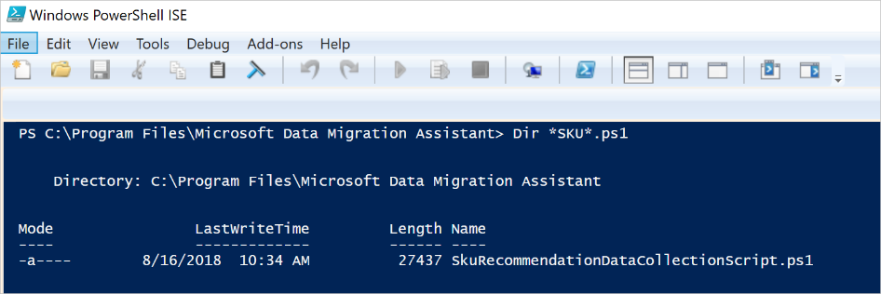
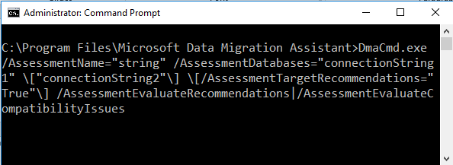
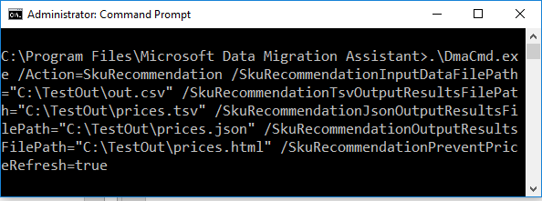
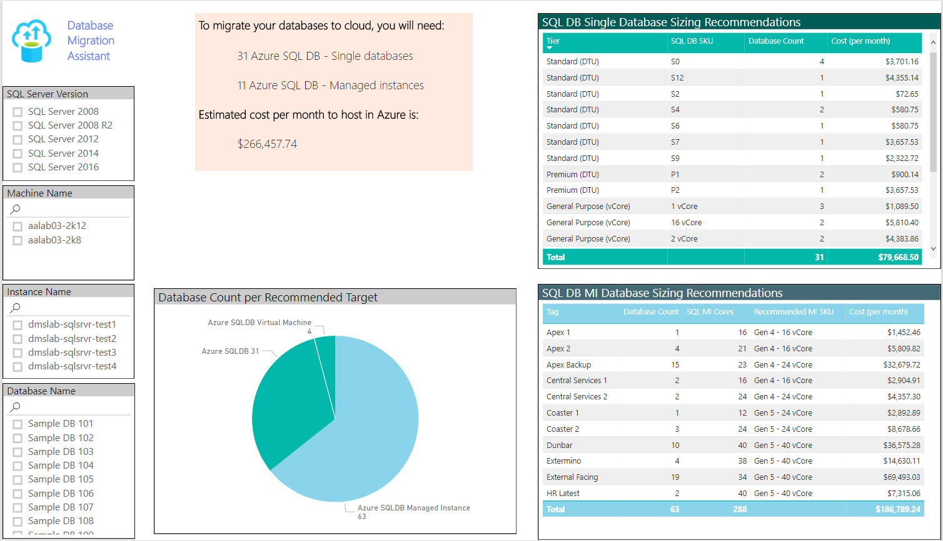
SKU Recommendation
Target Recommendation
Create database config file
Collect DMV statistics from your database
Run target recommendation using DMA CLI
Run SKU recommendation using DMA CLI
Power BI report

Slide 119
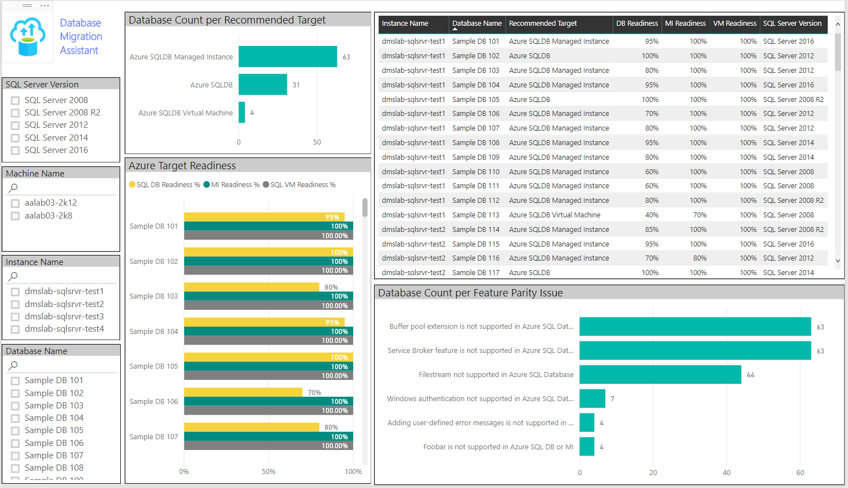

Slide 120
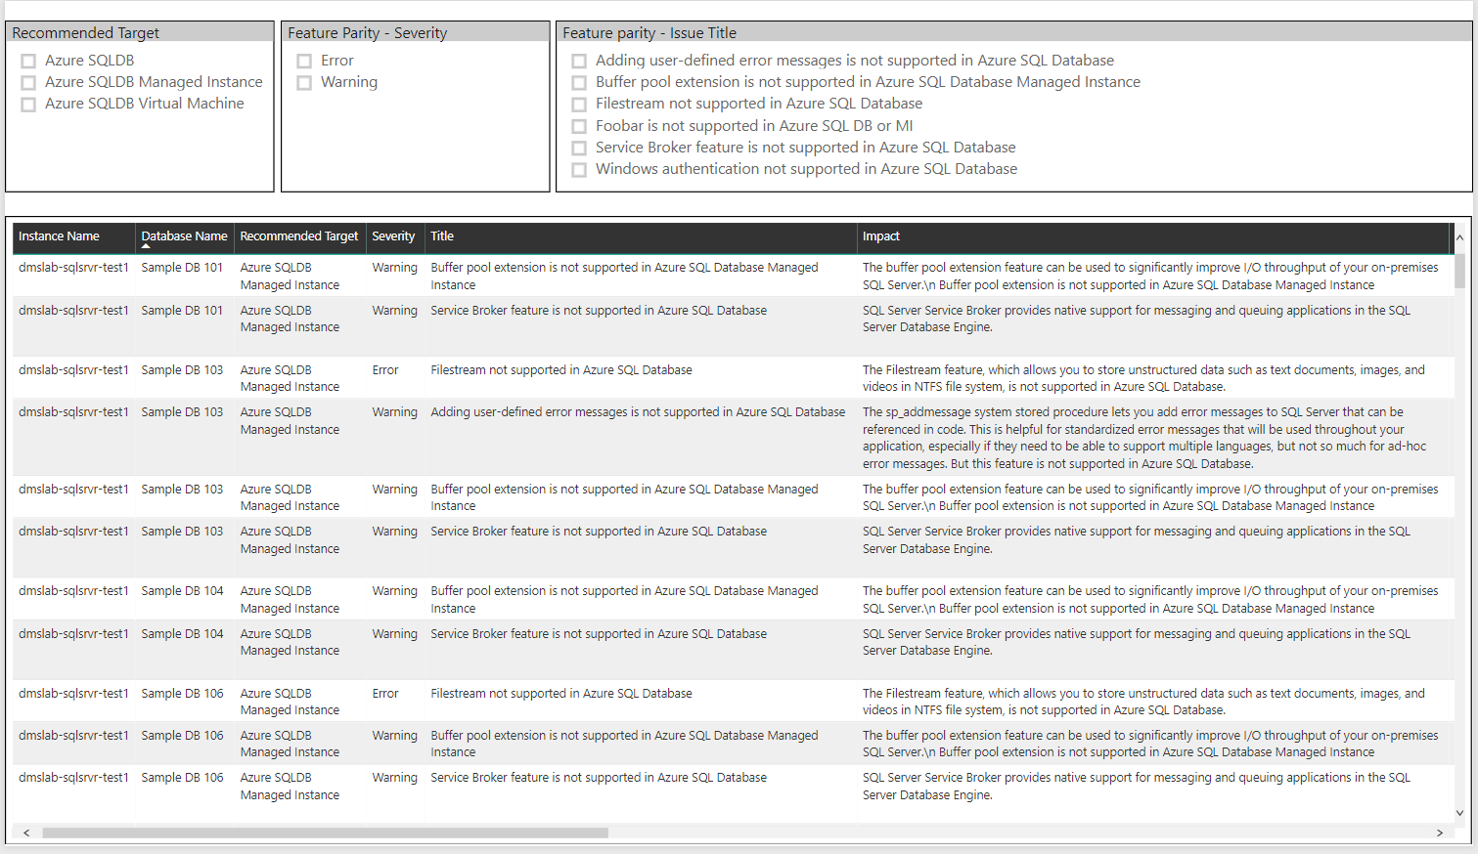

Slide 121
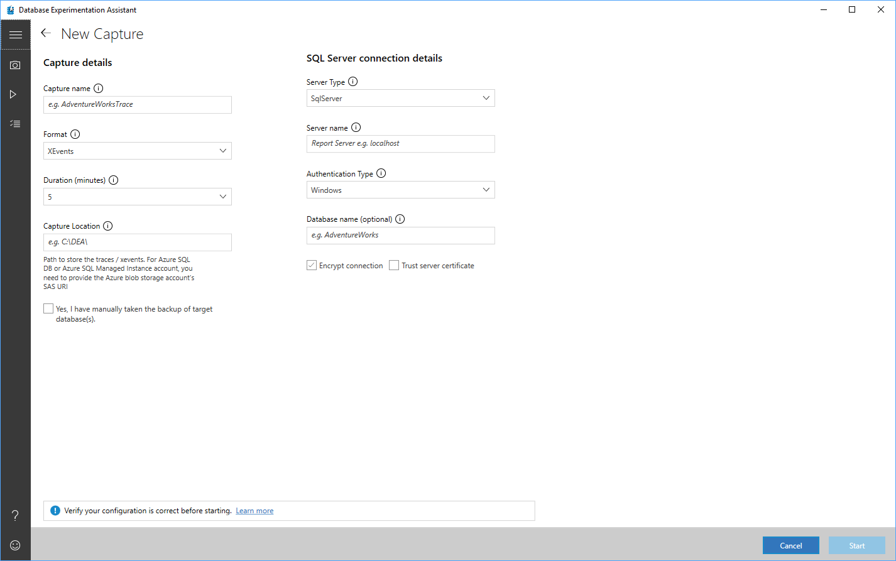

Slide 122
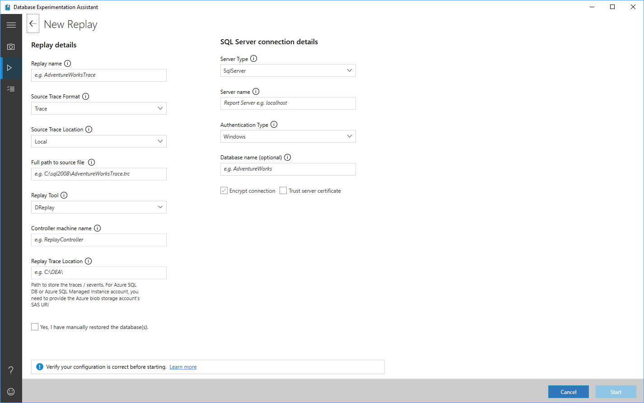
DEA – Relay 1

Slide 123
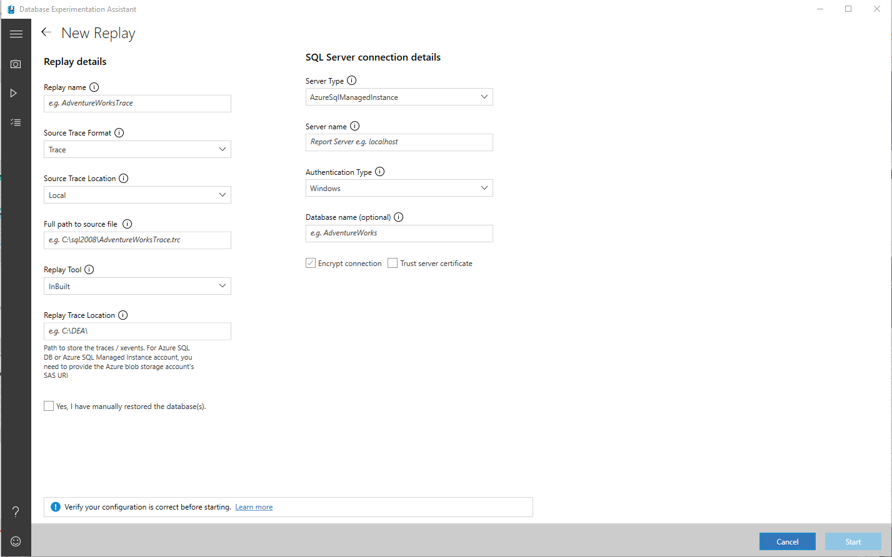
DEA – Relay 2

Slide 124
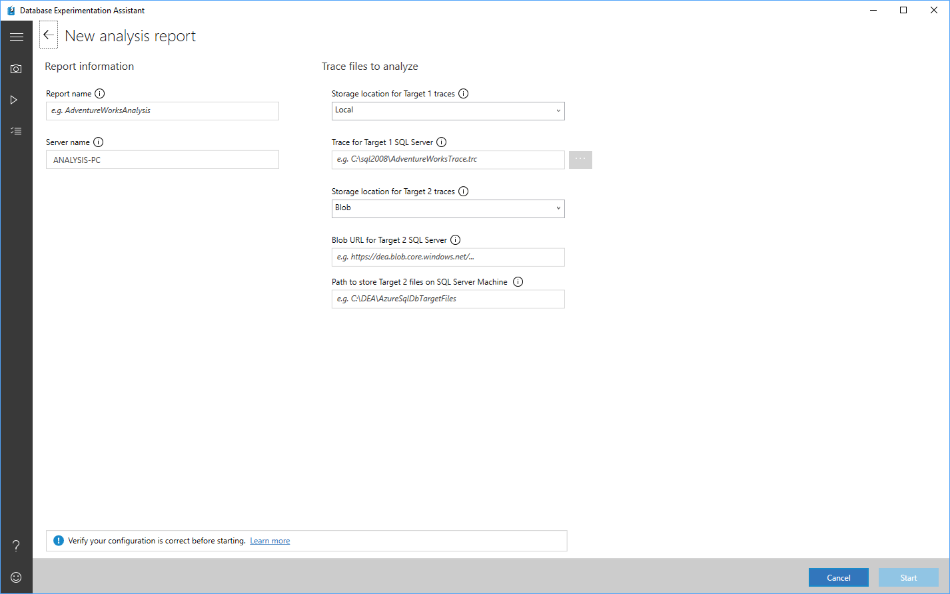
DEA - Analysis

Slide 125
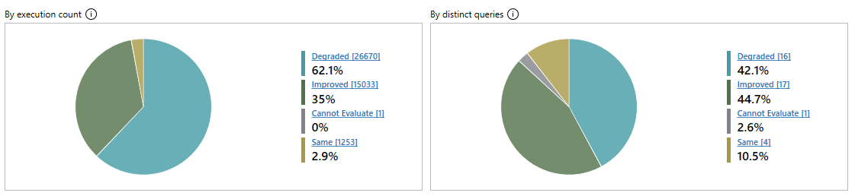
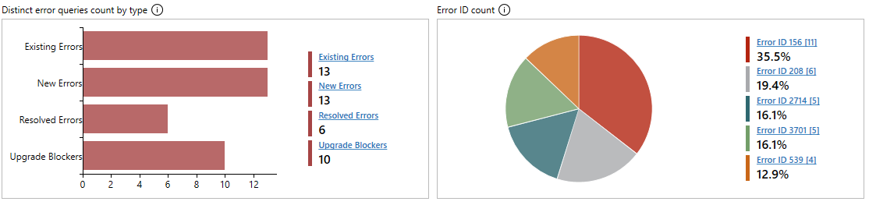
DEA - Report

Slide 126
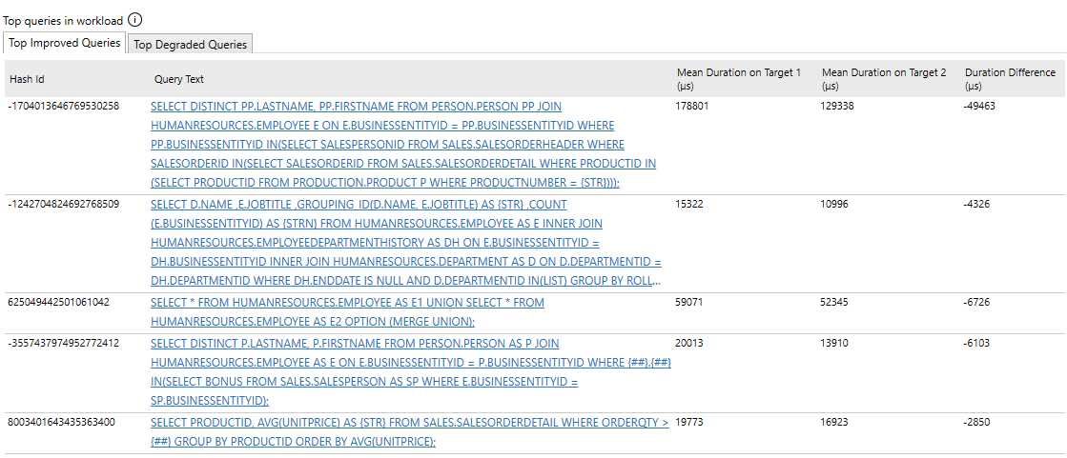
DEA - Analysis

Slide 127
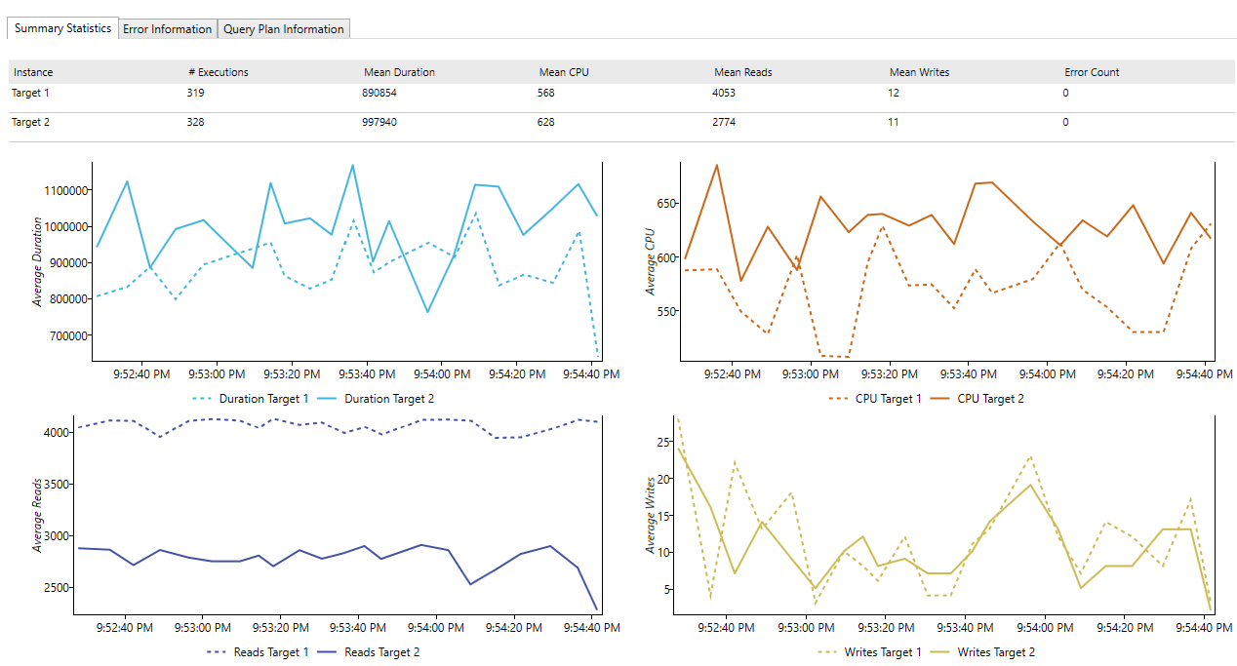
DEA - Report

Slide 128
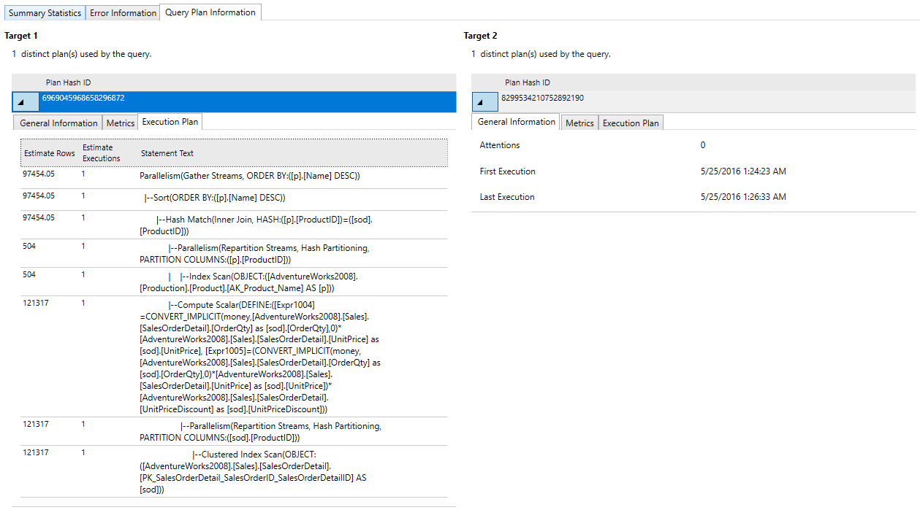
DEA - Report

Slide 129
Demo - Assessment
Notes:
Run DMA against AdventureWorks -> Azure SQL DB
Then run the assessment against AW -> SQL MI

Slide 130

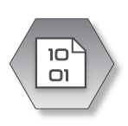



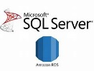










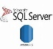
Azure Database Migration Service
Microsoft Subscription
Customer Subscription
On-Premise
Azure Resource Manager (ARM)
On-premises network
Azure Storage Account
Private ER
connection
My
Azure Portal
State management data
Migration results
Subnet used for DMS
ER Gateway
NIC
S2S VPN Tunnel
Virtual Machine
VPN
Gateway
PowerShell
DMS Resource Provider
VNET 1
Migration scenario server
VM locked down
Exclusive for DMS process
Auto upgrades
S2S SSTP
Tunnel
P2S SSTP/IKE
Tunnel
VNET peering
My
CLI commands
Authentication
Authorization
Throttling
VPN
Gateway
Service Bus Queue
VNET 2

Slide 131
Migrate Using SQL Managed Instance This lab demonstrates how to migrate a SQL database to a Azure SQL Database Managed Instance using the Azure Database Migration Service.
HOL
LAB
Notes:
Search for lab title on https://immtest-web.azurewebsites.net/handsonlabs
Steps in lab:
Create an Instance of Azure DMS – (some) prep steps
Create an Instance of Azure Data Migration Services
Create Storage SAS URI for DMS Migration Project
Create and Run a Migration Project
Navigate to the SQL Managed Instance Database

Slide 132
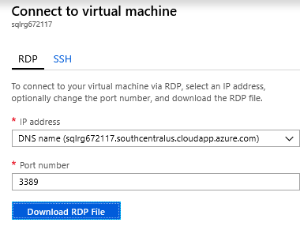
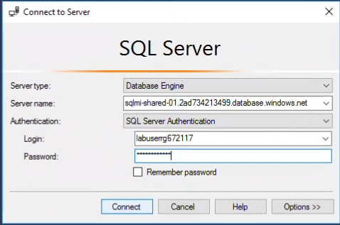
Connecting to lab Azure SQL DB Managed Instance
From Lab 2 – “Migration Using SQL Managed Instance”
RDP Username = labuser
RDP Password = Lab password
To connect to SQL MI use SSMS
SQL MI TEST = sqlmi-shared-01-test.568ebab56ce1.database.windows.net
SQL MI User = Labuser + resource group name ie (Labuserrg188393)
SQL MI password = Lab password (same as RDP password)

Slide 133



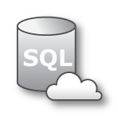


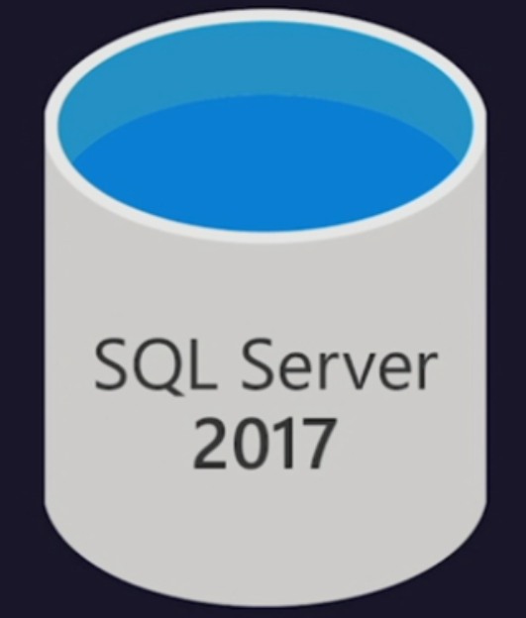


SQL -> SQL Database MI online migration workflow
Legend
Virtual Network ( VNET )
Full Database backup files
Subnet used for MI
Transaction log backup files
Site to site connectivity (VPN or ExpressRoute)
4
Azure Blob Storage
2
1
Provide existing backups in network share
Cloud network
SQL DB
Managed Instance
Subnet used for DMS
2
DMS upload backup files to Azure storage
3
3
DMS initiate the migration to Azure SQL MI
4
Full backup restored and Transaction log
backups continuously applied until cutover
1
SMB Network Share
Provide Tail-Log backup, initiate cutover in DMS and change the application connection strings
On-Premise

Slide 134

Migrating data to the cloud for greater agility
Background
Insurance Consulting and Technology (ICT) business group at Willis Towers Watson uses the latest technology to solve clients’ business problems by combining strategic and analytical skills
Client base: insurance companies, corporate clients, regulators, and other insurance-related entities
Receive data from clients in many different formats, and needed to ingest and normalize data to perform analytics
Customer challenge
Needed a scalable and elastic cloud solution
Cyclical peak workloads
Database sizes ranged from 25GB to 5TB
Laborious task to export to bacpac files, upload to Azure, and restore in Azure SQL
Impact
Successfully migrated 100 databases to Azure using Azure Database Migration Service without any downtime or loss
Scale instances as required during analytical cycles (monthly, quarterly, etc.)
Saved over 4 months of time that the internal team would have spent on migrations
“The Azure Database Migration Service was a game changer for us moving our databases to Azure. This process would have taken us well over six months and days/weeks of downtime for our users using any other method.”
Greg Matuskovic, Director - Solutions Architecture,
Willis Towers Watson

Slide 135
Resources
Azure Database Migration Service https://azure.microsoft.com/services/database-migration/
Preview signup: https://aka.ms/dms-preview
Feedback alias: dmsfeedback@microsoft.com
Channel 9 Video: Oracle migrations; Azure SQL Database migrations
Video: Online migrations to Azure SQL Database using Azure DMS
Video: Migrate MySQL applications to Azure with minimal downtime using the Azure Database Migration Service
Migration Guide datamigration.microsoft.com
SQL Server Migration Assistant: https://docs.microsoft.com/sql/ssma/sql-server-migration-assistant
Database Migration Assistant: https://blogs.msdn.microsoft.com/datamigration/dma/
Database Experimentation Assistant: Download
Find a partner: http://migration/Pages/SearchPartners.aspx
Data Migration Team Blog: blogs.msdn.microsoft.com/datamigration/

Slide 136
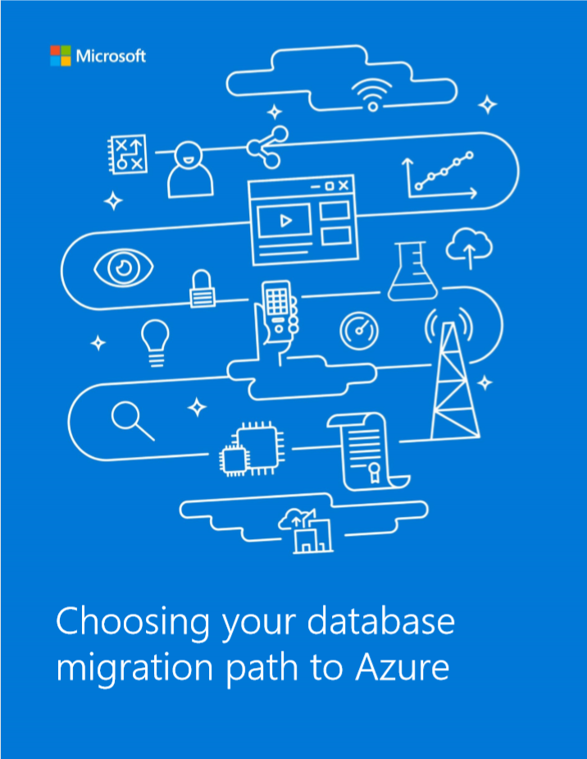
Your data migration path
https://azure.microsoft.com/en-us/resources/choosing-your-database-migration-path-to-azure/en-us/
Five steps to migrate
Initiate and discover
Access
Plan
Transform and optimize
Migrate, validate and remediate

Slide 137
Agenda
Intro to Azure SQL Database
Value prop, Platform benefits, TCO
Managed Instance overview
Managed Instance architecture, Features and management
Security & Networking
Security overview, Networking considerations, Hands-on-Lab
MI Features and capabilities
Key capabilities, limitations, backup & restore
Migration
Migration overview and options, Hands-on-Lab
MI & BI
Business Intelligence services + Managed Instance, Hands-on-Lab
Hyperscale
Hyperscale
Closing
Roadmap, technical resources, etc.,

Slide 138
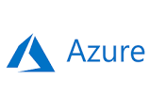

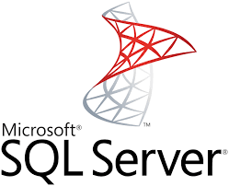
Migration to Azure
Managed Instance
SSIS in Azure Data Factory
Azure Analysis Services
Power BI
Replace / upload reports
Full compat
Tabular
Native restore of backups
Database Migration Service (near-zero-downtime)
Azure virtual machine
SQL Server engine
SSIS
SSAS
SSRS

Slide 139
Business Intelligence Services
Recommendation: move BI solutions to PaaS model
Not installed side-by-side with Managed Instance
Migrate your SSIS packages to new SSIS on Azure Data Factory (PaaS service)
Migrate your OLAP models to Azure Analysis Services
… or run these services in Azure virtual machines
For SSRS: run in a virtual machine, or switch to Power BI
Power BI
SSIS / SSAS PaaS
SQL
SQL Server Reporting Services
SSIS/SSAS
Notes:
SQL Database Managed Instance reduces the differences between on-premise SQL Server and a fully managed database service, so that the migration becomes much easier.
SQL Database Managed Instance offers a simplified instance-scoped programming model that is like an on-premises SQL Server instance. The databases in Managed Instance share the resources allocated to the Managed Instance, and the Managed Instance also represents the management grouping for these databases. The emphasis of this offering is on high compatibility with the programming model of on-premises SQL Server and out-of-box support for the large majority of SQL Server features and accompanying tools/services.

Slide 140
Lift your SQL server integration services (SSIS) packages to azure
Azure Data Factory
SSIS Integration Runtime
Easily execute and schedule your SQL Server Integration Services (SSIS) packages in managed execution environment for SSIS in Azure Data Factory version 2 (ADF v2)
Gain high availability, scalability and lower TCO by lifting your SSIS packages to Azure
Continue to build, monitor and manage packages with existing tools like SQL Server Management Studio (SSMS) & SQL Server Data Tools (SSDT)
You can install both free or unlicensed components, and paid or licensed components!
Learn more
SQL
Data sources
SSIS ETL
SQL Database
Managed Instance
Cloud
On-premises
VNET
SQL
SSIS ETL
Data sources
SQL Server
Available Q2 CY 2018

Slide 141
SQL Managed Instance data integration and business intelligence Learn to control the seamless orchestration of your enterprises' data integration efforts through an extensive tour of Azure Data Factory.
HOL
LAB
Notes:
Search for lab title on https://immtest-web.azurewebsites.net/handsonlabs
Steps in lab:

Slide 142
Agenda
Intro to Azure SQL Database
Value prop, Platform benefits, TCO
Managed Instance overview
Managed Instance architecture, Features and management
Security & Networking
Security overview, Networking considerations, Hands-on-Lab
MI Features and capabilities
Key capabilities, limitations, backup & restore
Migration
Migration overview and options, Hands-on-Lab
MI & BI
Business Intelligence services + Managed Instance, Hands-on-Lab
Hyperscale
Hyperscale
Closing
Roadmap, technical resources, etc.,

Slide 143
What is Hyperscale?
Hyperscale is an all new storage layer under the database
Hyperscale is architected for the cloud from the ground up
Hyperscale is fully compatible with Azure SQL Database
Hyperscale is no limits
Hyperscale is VLDB size without the VLDB headaches
Support for 100TB+

Slide 144
Hyperscale your database
SQL Database Hyperscale
Read and Write
Read Only
A new, highly scalable service tier that adapts on-demand to your workload's needs, auto-scaling up to 100TB per database
Storage dynamically adapts to your workloads’ needs, auto-scaling up to 100TB
Provision one or more additional compute nodes that can serve your read-only workload and use them as a hot-standby, in case of failover
Perform operations in constant time, regardless of the size of the data operation
Compute and storage resources scale rapidly and independently without sacrificing performance
HS_Gen4_4
HS_Gen4_4
HS_Gen4_4
RBPEX Data Cache
RBPEX Data Cache
RBPEX Data Cache
Primary Compute
sqlservr.exe
Secondary Compute
sqlservr.exe
Secondary Compute
sqlservr.exe
Compute
Log Service
Landing Zone
(Azure Premium Storage)
Log Destaging
Log Cache
Page Servers
Long Term Storage for PITR
(Azure Standard Storage)
Log
Covering RBPEX Data Cache
Covering RBPEX Data Cache
…..
Covering RBPEX Data Cache
1 TB data file
1 TB data file
1 TB data file
Data Pages
Data Pages
…..
Data Pages
Local SSD Cache
File Snapshots
File Snapshots
File Snapshots
RBPEX
Resilient Buffer Pool Extension
Azure Storage
Log Pathway
Data Pathway
Notes:
Azure SQL Database Hyperscale is a new, highly scalable service tier that adapts on-demand to your workload's needs, quickly auto-scaling up to 100TB per database, eliminating the need to pre-provision storage resources and significantly expanding the potential for app growth without being limited by storage size. This new service tier also provides the ability to scale compute and storage resources independently, giving you the flexibility to optimize performance for your workloads. Azure SQL Database Hyperscale will initially be available for single database resource types.
Hyperscale is currently in preview and initially available for single databases in the following regions, with more regions added over time: West US1, West US2, East US1, Central US, West Europe, North Europe, UK West, SouthEast Asia, Japan East, Korea Central, Australia SouthEast, Australia East

Slide 145
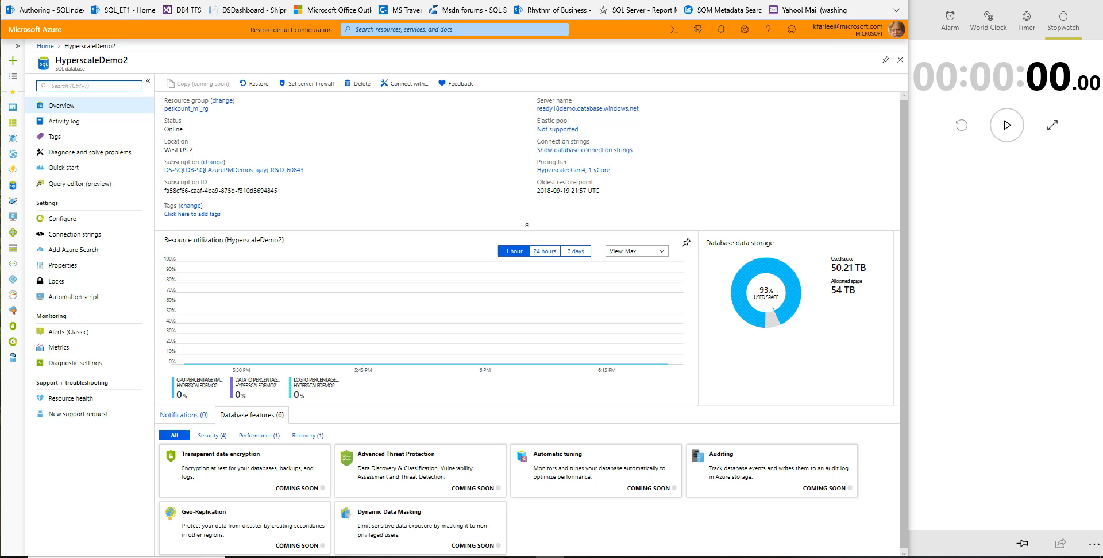

Slide 146
Agenda
Intro to Azure SQL Database
Value prop, Platform benefits, TCO
Managed Instance overview
Managed Instance architecture, Features and management
Security & Networking
Security overview, Networking considerations, Hands-on-Lab
MI Features and capabilities
Key capabilities, limitations, backup & restore
Migration
Migration overview and options, Hands-on-Lab
MI & BI
Business Intelligence services + Managed Instance, Hands-on-Lab
Hyperscale
Hyperscale
Closing
Roadmap, technical resources, etc.,

Slide 147

MI Roadmap
Post - GA
Non-UTC time (EoY 18)
Geo-restore (Q1 CY19)
Sovereign clouds (Q2 CY19)
Forced tunneling for data traffic (Q1 CY19)
Custom maintenance window (Q2 CY19)
Instance pools with small size instances
(1 vCores) – Q1 CY19
Business model, Portal UX
Instance level HA, Gen 4
VNET (private IP)
SQL Server compat: Restore, Cross-db queries, Linked Server, SQL Agent, Db Mail, Service Broker, SQL Audit
Azure compliance signed off
General Purpose Public Preview
March 7
Business Critical Public Preview
July 16
General Purpose GA
End of September (Ignite)
Business Critical GA
November (Connect)
2018
Mar
May
Jul
Sep
Nov
Dec
Jan
2019
Business model
Reserved instance/capacity
Dev/test licenses (gated)
Networking
Streamlined provisioning
Traffic filtering (NSGs)
Migration friction
DMS: assessment and min-down time migration
Transactional Replication
AAD logins, instance collations, non-UTC time (preview)
Analytics and Intelligent Insights for MI
Vulnerability Assessment
Business model
Dev/test licenses
Configurable backup retention
Networking
Public endpoint
Built-int firewall
Migration friction
AAD logins
Instance Collations
TDE BYOK – AKV
Geo DR /FOG
Online service tier update
SSDT / DaCFx
Network Intent Based Policy
Service tier update (within tier)
Large instance (32, 40, 80)
Gen 5
SSIS PaaS
SCOM Management Pack

Slide 148
Security Roadmap
Data Classification
Event Hub Integration
3rd party SIEM solutions
Completing AAD Auth
TDE w/AKV (BYOK)
Public Endpoint
Full portal support for all security features
…

Slide 149
Documentation
Document | When to use it
What is a Managed Instance (preview)? | High level details about SQL MI – service description and positioning
Azure SQL Database pricing page | Business model and pricing details
Azure Hybrid Use Benefit (AHUB) | Discount details for customers with SQL Server licenses
Feature comparison: Azure SQL Database versus SQL Server | High level feature availability matrix and need comparison with SQL Server and rest of SQL Database
Azure SQL Database Managed Instance T-SQL differences from SQL Server | Detailed functional behavior of SQL MI
Create Managed Instance - Tutorial | How to create SQL MI and connect to it (quick getting started guide)
How To: Configure a VNet for Azure SQL Database Managed Instance | How to makes sure that VNet is compliant with SQL MI requirements
How To: Configure a Custom DNS for Azure SQL Database Managed Instance | Networking misconfiguration is currently the most frequent reason that prevents customers from deploying SQL MI successfully
Connect your application to Azure SQL Database | High level of detail how to connect app to MI (supported scenarios, high level steps, links on detailed how-to)
SQL Server instance migration to Azure SQL Database Managed Instance | Various options to migrate application to SQL MI
https://docs.microsoft.com/en-us/azure/sql-database/sql-database-managed-instance-resource-limits | Subscription-level quotas and official process to obtain larger quota
Azure Support plans | Explore the range of Azure support options and choose the plan that best fits, whether you're a developer just starting your cloud journey or a large org. deploying business-critical, strategic applications
How to create Azure support request | Step by step instructions to open support ticket

Slide 150
Blogs, best practices
Document | When to use it
Managed Instance ARM template reference Create SQL MI using ARM templates Change size of SQL MI using PowerShell | SQL MI management through ARM templates & PowerShell (official docs and blogs)
Cross-instance point-in-time restore in Azure SQL Database Managed Instance | How to restore database to another instance
CAT Blog: CPU and Memory Allocation on Azure SQL Database Managed Instance | Explains how to interpret various information exposed in SSMS and DMVs regarding resource allocation is SQL MI
CAT Blog: Storage best practices in General Purpose | In this article, we describe database storage architecture on Azure SQL Database Managed Instance (MI), for General Purpose (GP) instances specifically. We also provide a set of best practices to help optimize storage performance
CAT Blog: Consume SQL MI Error Log | How to filter out unnecessary info from SQL error log and focus on what's important to your app using sp_readmierrorlog
CAT Blog: Real time performance monitoring for Azure SQL DB Managed Instance | Configuring and suing Telegraf for real-time perf. monitoring in SQL Managed Instance
BLOG: How to send emails in SQL MI using DbMail
SCOM Management Pack for SQL MI | The blog announcement for SCOM MP for SQL MI and scope details

